Slide 1
How Will AI Affect Career and Technical Education Students?
Cameron Sublett, PhD
Associate Professor and Director

Slide 2
Overview
Definition and Brief History of Career and Technical Education
Potential Impacts of AI on CTE Programs and Students
Policy and Practice Solutions

Slide 3
What is Career and Technical Education (CTE)?
“Courses (at the high school level) and programs (at the postsecondary subbaccalaureate level) that focus on the skills and knowledge required for specific jobs or fields of work” (NCES, 2023).
Practically speaking, CTE equips students with technical skills that are closely tethered to specific workforce applications—think carpentry or plumbing
“Vocational education”

Slide 4
What is Career and Technical Education (CTE)?
Vocational/CTE
Academic
Applied
Technical “know how”
Specific applications
Workforce-specific
Theoretical
Subject “know about”
Broad applications
Workforce-general

Slide 5
What is Career and Technical Education (CTE)?
Vocational/CTE
Academic
Agriculture
Computer and Information Sciences
Health Sciences
Manufacturing
Engineering Technologies
Liberal Arts
Natural Sciences and Mathematics
Social Sciences
History
Psychology

Slide 6
What is Career and Technical Education (CTE)?
CTE Career Clusters
Agriculture, Food & Natural Resources
Architecture & Construction
Arts, A/V Technology & Communications
Business Management & Administration
Education & Training
Finance
Government & Public Administration
Health Science
Hospitality & Tourism
Human Services
Information Technology
Law, Public Safety, Corrections & Security
Manufacturing
Marketing
Science, Technology, Engineering & Mathematics
Transportation, Distribution & Logistics

Slide 7
Evolution of CTE Policy
The Morrill Act of 1862 led the development of land-grant colleges to teach agricultural and mechanical arts to the “industrial classes”
The first federal legislation to devote resources to vocational education as an expression of education policy was the Smith-Hughes Act of 1917
Manpower Development and Training Act of 1962 sought to address high unemployment by retraining individuals with obsolete skills to suit rapidly advancing technology
The 1963 Vocational Education Act supported vocational education schools; vocational work-study programs; and research, training, and demonstration programs related to vocational education

Slide 8
Evolution of CTE Policy
Carl D. Perkins Vocational Education Act of 1984 (Perkins I) aimed to restore credibility in vocational education through increased program quality and equity
Carl D. Perkins Vocational Education and Applied Technology Act of 1990 (Perkins II) built on Perkins 1 by emphasizing the need for integrating academic components into vocational education programs and continuing education through high school
Carl D. Perkins Vocational and Technical Education Act of 1998 (Perkins III) continued the basic idea of Perkins 1 and II, with additional focus on “special populations” and performance data
Carl D. Perkins Career and Technical Education Act of 2006 (Perkins IV) emphasized “rigorous and relevance,” “academic integration” and workforce alignment
Strengthening Career and Technical Education for the 21st Century Act of 2018 (Perkins V) defined CTE “concentration,” further emphasized workforce alignment through the Comprehensive Local Needs Assessment, employability of student completers, and funding set asides

Slide 9
CTE Today
Public and political support for technical education and training is high and rising
CTE advocates would assert the evolution of CTE policies overtime have virtually erased the “vocational” vs “academic” distinction
Existing research suggests contemporary CTE is less stratified along racial, gender, and class lines
Shifts towards “relevance and rigor” and workforce alignment suggest contemporary CTE no longer acts to prep students for “dead end careers”

Slide 10
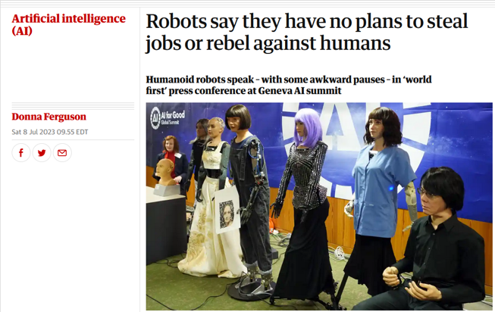
Potential Impacts of AI on CTE Students
Technology has always been a social and economic disruptor
Recent advancements represent something new
Advancements in computer science, machine learning and the arrival of big data paved the way for the development of large language models (LLMs)
LLMs have the ability to supercharge artificial intelligence (AI) capabilities
New AI will undoubtedly fuel workforce automation – the questions are how, when, and where

Slide 11
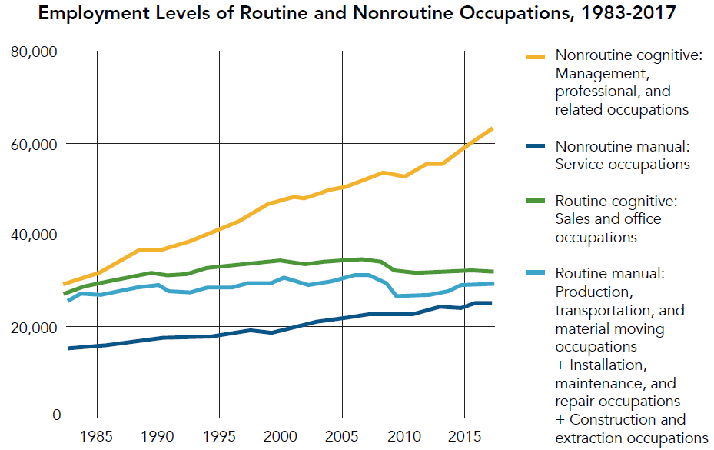
Potential Impacts of AI on CTE Students
What we do know:
  Occupations involving routine cognitive and physical tasks are at greatest risk of automation
  By contrast, occupations requiring higher levels of education and involving a mix of soft and process skills are at lower risk, overall

Slide 12
Potential Impacts of AI on CTE Students
What we do know:
  Occupations involving routine cognitive and physical tasks are at greatest risk of automation
  By contrast, occupations requiring higher levels of education and involving a mix of soft and process skills are at lower risk, overall
Connection to CTE?
The world of work increasingly favors transferrable skills, not technical skills
    Two-way communication
    Critical thinking
    Creativity
    Problem-solving
Contemporary CTE needs to equip student with both
I’m not convinced we are succeeding

Slide 13
Potential Impacts of AI on CTE Students
Existing CTE Career Cluster framework, programs, curriculum and instructional models have the potential to (once again) act as a sorting mechanism
“Tracking 2.0”
  “Dark history” of CTE becomes its future
  Re-igniting the “academic” vs “vocational” divide
    Unequal opportunity, unequal outcomes
  Moving students within CTE clusters rich in transferrable skills into positions of advantage
  Moving students within CTE clusters deficit in transferrable skills into positions of risk

Slide 14
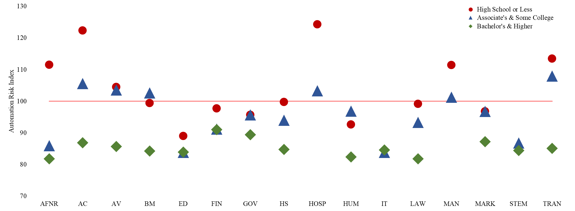
Potential Impacts of AI on CTE Students
Average automation risks decrease as education level goes up, largely because jobs requiring bachelor’s degrees involve a greater number of transferable skills that are less easy to automate. Keep in mind federal policy largely funds secondary and subbaccalaureate postsecondary CTE providers.

Slide 15
Potential Impacts of AI on CTE Students
Second, some CTE career-cluster areas have average automation risks that are low: (ED, IT, STEM). Other CTE career-cluster areas have automation risks that are high: (AC, HOSP, MAN, TRAN)

Slide 16
Potential Impacts of AI on CTE Students
Third, the gap between the lowest and highest levels of education is greatest in clusters with the highest aggregate automation risk, which suggests the academic-integration hurdle is higher in these clusters compared with others

Slide 17
Policy and Practice Solutions
In theory, CTE students should be better prepared for automation compared to “academic” students
Perkins IV & V
  Academic integration
  Comprehensive Local Needs Assessment
  Apprenticeships and work-based learning
  Special Populations set-aside
The challenge is implementation and the pace of advancement
The future is uncertain, but it’s clear future learners will need a blend of technical and transferrable education

Slide 18






