Slide 1
Being an Effective Employer Partner with Talent Pipeline Management (TPM)
Beyond Stakeholders, to Co-Creators

Slide 2
Agenda
Welcome + Introductions
Overview of TPM
Connecting TPM + CTE
Activity: Scanning to get started
Report outs + Questions

Slide 3
Goals
Identifying your role in a talent supply chain.
Promote shared understanding.
Build or strengthen partnerships between CTE providers and employers.
Notes:
1) provides an orientation to TPM as a framework for organizing employers and talent supply chain partnerships that create shared value for learners, education and workforce providers, and employers; (2) explains how TPM can be used to improve communication and promote shared understanding between employers and the CTE community; and (3) describes how TPM can be leveraged as a transformative approach for engaging employers in CTE program design, delivery, and improvement, especially in ways that expand equity and diversity

Slide 4
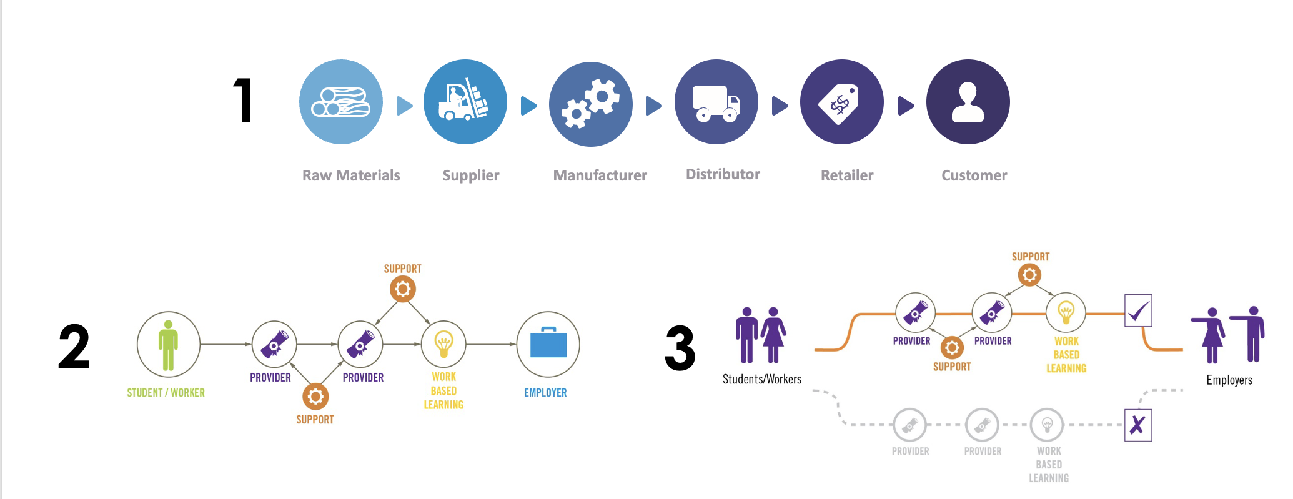
What is Talent Pipeline Management?

Slide 5

STEEL
Notes:
A TPM partner once said to us: “We don’t post ads on our doors that say ‘Steel Wanted’ and expect steel to show up the next day …

Slide 6
The Evolution of TPM
A growing movement of over 900 TPM Academy graduates in 46 states, D.C., and Canada involving thousands of employers
2014: White paper released at a national workforce conference
2015: 7 pilot projects exploring talent supply chain strategies
2016: First TPM Academies launched
2018: Launched TPM National Learning Network
2019: New resources for upskilling current workers, new TPM Academies, launch of TPM Fellows Program
2020: New resources for CTE and opportunity populations, TPM Next
2021: Development of TPM Co/Lab, digital badges and peer review process.
2022: Partnership with SHRM to develop TPM Academy summative assessment and SHRM PDCs.
2023: Launched TPM Co/Lab online learning platform for the TPM Academy and Opportunity Populations.

Slide 7
What Makes TPM Different?
Notes:
What Makes TPM Different?
Built on industry best practices
Focused on employer-ROI
Authentically employer-led
Provides an agile framework for collective action and decision making
Generates more granular and actionable data on workforce demand
Engages the full spectrum of talent sourcing partners
Creates shared value, competitiveness, and accountability

Slide 8
The TPM Framework

Slide 9
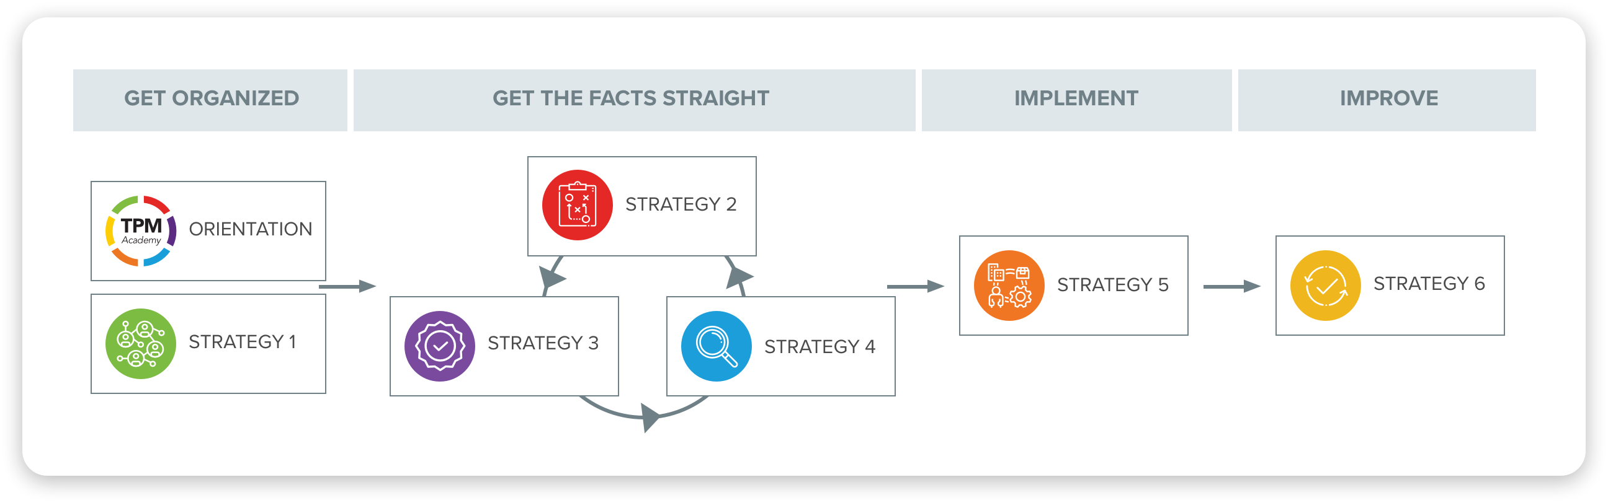
A flexible framework to meet your needs

Slide 10
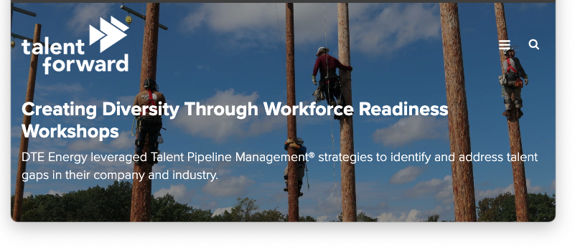
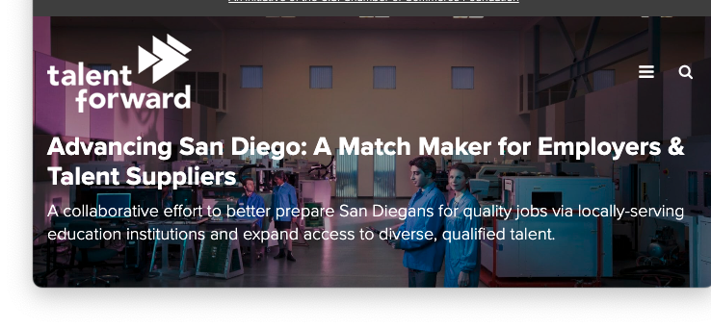
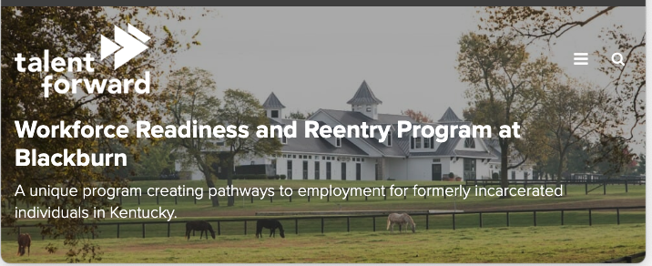
Current Outcomes
Onboarding Costs
Retention
Career Advancement
Workforce Diversity
Notes:
These partners are achieving shorter time to fill positions, lower onboarding costs, improved retention, better career advancement pathways, and increased workforce diversity.
We’ve printed out a case study that demonstrates some of these outcomes for you, and are happy to provide more examples of success for our partners.
What started as an initiative funded fully by philanthropic foundations has evolved into trainings and resources that people across the country—and in some cases the world—will pay for because they recognize the value and see the difference in this approach compared to other workforce efforts.

Slide 11
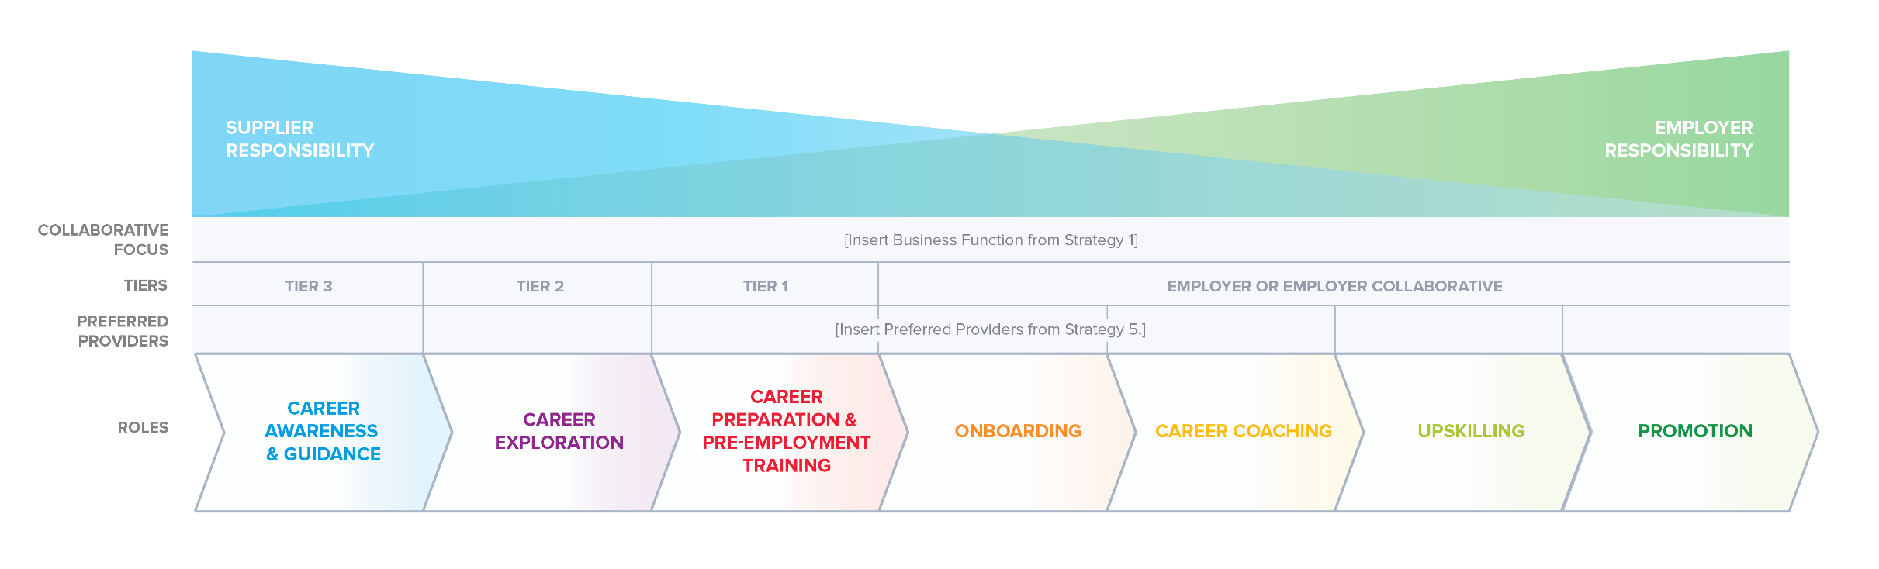
Why TPM for CTE?
Notes:
Key Takeaways: Setting the table for why a talent-focused initiative is needed
Employers struggle to find the talent they need to fill in-demand, critical jobs; educators find it difficult to know and respond to employer’s dynamic needs, and learners (students/workers) require more transparency and information as they transition from education/training to the workforce.
Common challenge is ability to keep employers at the table—many play an advisory role for an institution or are part of a public-private partnership but have not experienced enough of an ROI to take their engagement to the next level.
The investments of time and money are critical factors to weigh when engaging in a new initiative and therefore to be able to demonstrate a return on investment is critical.
In today’s economy, employers must constantly restructure work roles, skills requirements, and career pathways in order to adapt to the modern competitive business environment
TPM organizes employers around critical jobs in well defined geographic areas using trusted employer associations or other intermediaries.​
TPM helps develop the information CTE professionals need in order to start partnerships and develop programs, or improve on existing relationships and programs.​
TPM provides an employer-led process for engaging CTE partners in developing talent pipeline solutions that serve as high-performing career pathways for CTE programs of study.

Slide 12
Upskilling Specialty Nurses
The Challenge ​
LMI showed critical shortage in medical assistants, but the real pain point was specialty nurses.
Employers were spending $10,000/new hire to upskill internally and supplementing need with travel nurses.
There were no training programs in the area dedicated to these critical specialty areas.
Notes:
Due to critical healthcare skills shortages in the region, the Greater Phoenix Chamber Foundation organized the Hospital Workforce Collaborative using TPM. Traditional labor market data indicated that the lack of medical assistants was the hospitals’ major pain point. However, data produced by the collaborative members themselves using the TPM framework revealed their greatest need was actually in developing and retaining nurses in six specialty practice areas; occupations that were not even reflected in traditional labor market information tools.
The collaborative of employers established a partnership with the Maricopa County Community College District (MCCCD). In addition to using the TPM framework to determine the focus of the collaborative, they used it to assess the facilities and resources needed to deliver specialty nursing training across the district’s 10 community colleges. This planning process identified a need for additional simulation facilities and labs that can meet the needs of the employer collaborative and region.
Through coordination and support of the collaborative and business community, MCCCD was able to secure an appropriation of $5.8 million from the state legislature to develop a new clinical simulation facility. The leadership of the collaborative in the planning and need assessment process paid off.
The program boasts a potential for graduating up to 300 students by 2021, doubling the current number of nursing students in the region. Combined with an increase of at least five new programs and multiple tracts for upskilling existing working nurses, the potential for growth of the healthcare workforce in Arizona is extraordinary.
https://www.forwardontalent.org/stories/hospital-workforce-collaborative/

Slide 13
Upskilling Specialty Nurses
The Solution ​
Identify key community, government and education partners to develop a new upskilling program in six key specialty areas. ​
The key education partner? Maricopa County Community College District (MCCCD).
Assessed facilities: additional simulation facilities and labs
Assessed faculty: redirecting internal hospital faculty to train in the new facility
Assessed resources: financial support for new clinical space
Notes:
Due to critical healthcare skills shortages in the region, the Greater Phoenix Chamber Foundation organized the Hospital Workforce Collaborative using TPM. Traditional labor market data indicated that the lack of medical assistants was the hospitals’ major pain point. However, data produced by the collaborative members themselves using the TPM framework revealed their greatest need was actually in developing and retaining nurses in six specialty practice areas; occupations that were not even reflected in traditional labor market information tools.
The collaborative of employers established a partnership with the Maricopa County Community College District (MCCCD). In addition to using the TPM framework to determine the focus of the collaborative, they used it to assess the facilities and resources needed to deliver specialty nursing training across the district’s 10 community colleges. This planning process identified a need for additional simulation facilities and labs that can meet the needs of the employer collaborative and region.
Through coordination and support of the collaborative and business community, MCCCD was able to secure an appropriation of $5.8 million from the state legislature to develop a new clinical simulation facility. The leadership of the collaborative in the planning and need assessment process paid off.
The program boasts a potential for graduating up to 300 students by 2021, doubling the current number of nursing students in the region. Combined with an increase of at least five new programs and multiple tracts for upskilling existing working nurses, the potential for growth of the healthcare workforce in Arizona is extraordinary.
https://www.forwardontalent.org/stories/hospital-workforce-collaborative/

Slide 14
Upskilling Specialty Nurses
The Results ​
By partnering together MCCCD and the employer collaborative were able to secure $5.8 Million in state funding for new clinical simulation facility. ​
Goal of over 300 students to graduate from the program in the first two years.
Notes:
Due to critical healthcare skills shortages in the region, the Greater Phoenix Chamber Foundation organized the Hospital Workforce Collaborative using TPM. Traditional labor market data indicated that the lack of medical assistants was the hospitals’ major pain point. However, data produced by the collaborative members themselves using the TPM framework revealed their greatest need was actually in developing and retaining nurses in six specialty practice areas; occupations that were not even reflected in traditional labor market information tools.
The collaborative of employers established a partnership with the Maricopa County Community College District (MCCCD). In addition to using the TPM framework to determine the focus of the collaborative, they used it to assess the facilities and resources needed to deliver specialty nursing training across the district’s 10 community colleges. This planning process identified a need for additional simulation facilities and labs that can meet the needs of the employer collaborative and region.
Through coordination and support of the collaborative and business community, MCCCD was able to secure an appropriation of $5.8 million from the state legislature to develop a new clinical simulation facility. The leadership of the collaborative in the planning and need assessment process paid off.
The program boasts a potential for graduating up to 300 students by 2021, doubling the current number of nursing students in the region. Combined with an increase of at least five new programs and multiple tracts for upskilling existing working nurses, the potential for growth of the healthcare workforce in Arizona is extraordinary.
https://www.forwardontalent.org/stories/hospital-workforce-collaborative/

Slide 15
Upskilling Specialty Nurses
The Results ​
By partnering together MCCCD and the employer collaborative were able to secure $5.8 Million in state funding for new clinical simulation facility. ​
Key Takeaways​
TPM can strengthen the comprehensive local needs assessment (CLNA) by:
Strategy 1: Establishing employer collaboratives
Strategy 2: Providing more up-to-date and detailed information on projected job openings for these jobs
Strategy 3: Providing detailed information on hiring requirements
Strategy 4: Providing a new and more accurate approach to supply-demand analysis on CTE programs.
Notes:
TPM can strengthen the comprehensive local needs assessment (CLNA) by:
Strategy 1: Establishing employer collaboratives that can actively participate in the needs assessment process and identify the most critical in-demand jobs at the state and local levels.
Strategy 2: Providing more up-to-date and detailed information on projected job openings for these jobs and the lead times for filling them, that can be used in establishing local program of study priorities.
Strategy 3: Providing detailed information on hiring requirements, including competency and credential requirements that can be used to identify industry-recognized credentials and define the competencies and credentials addressed in CTE programs of study.
Strategy 4: Providing a new and more accurate approach to supply-demand analysis and determining which existing CTE programs are actually supplying qualified talent for in-demand jobs within their local areas and the capacity of these programs to meet projected future demand.

Slide 16
A Community College Maximizes Industry Relevance
The Challenge
Northern Kentucky was struggling to fill their demand for manufacturing talent.
Experiencing low retention and productivity.
Notes:
In Northern Kentucky, a manufacturing partnership used TPM to identify Gateway Community and Technical College as a preferred provider of machinist talent. The TPM framework enabled the employer collaborative to better organize and communicate their hiring requirement as part of the program design and implementation process. Equipped with this data, Gateway was able to transform a traditional machinist program into an employer-led enhanced operator program.
Using the competency and skill-based hiring requirements agreed to by the collaborative, the employer partners were able to engage in a competency and curriculum mapping process with Gateway. In addition to improving alignment, the partners were able to identify numerous areas of duplication where employers were better positioned to cover as part of their onboarding processes. The result: reduced time and cost in delivering the program. By employers using the TPM framework to define and prioritize the competencies needed to meet industry requirements, Gateway was able to target its coursework to give students the right level of information in the most efficient timeframe. From there, employers could provide more targeted onboarding processes to get employees to full productivity in an effective and efficient manner.
As a result, the newly minted operator program went from a one-year completion time to 14 weeks, and the cost was cut by close to half (from $5,000 to $2,588). With a focus on competency-based learning, program completers were able to finish the program well-equipped to meet the employers’ needs. After several iterations of continuous improvement, one thing has not changed: employers drive the curriculum conversation from beginning to end to ensure Gateway provides students training for the most relevant industry skills.
https://www.forwardontalent.org/stories/scjohnson/

Slide 17
A Community College Maximizes Industry Relevance
The Solution
Manufacturing collaborative identified partnership with Gateway Community and Technical College for machinist talent.
Communicated their hiring and skills requirements to redesign the traditional machinist program to an enhanced operator program.
Identified numerous areas of duplicative training between employers and education program.
Notes:
In Northern Kentucky, a manufacturing partnership used TPM to identify Gateway Community and Technical College as a preferred provider of machinist talent. The TPM framework enabled the employer collaborative to better organize and communicate their hiring requirement as part of the program design and implementation process. Equipped with this data, Gateway was able to transform a traditional machinist program into an employer-led enhanced operator program.
Using the competency and skill-based hiring requirements agreed to by the collaborative, the employer partners were able to engage in a competency and curriculum mapping process with Gateway. In addition to improving alignment, the partners were able to identify numerous areas of duplication where employers were better positioned to cover as part of their onboarding processes. The result: reduced time and cost in delivering the program. By employers using the TPM framework to define and prioritize the competencies needed to meet industry requirements, Gateway was able to target its coursework to give students the right level of information in the most efficient timeframe. From there, employers could provide more targeted onboarding processes to get employees to full productivity in an effective and efficient manner.
As a result, the newly minted operator program went from a one-year completion time to 14 weeks, and the cost was cut by close to half (from $5,000 to $2,588). With a focus on competency-based learning, program completers were able to finish the program well-equipped to meet the employers’ needs. After several iterations of continuous improvement, one thing has not changed: employers drive the curriculum conversation from beginning to end to ensure Gateway provides students training for the most relevant industry skills.
https://www.forwardontalent.org/stories/scjohnson/

Slide 18
A Community College Maximizes Industry Relevance
The Result
Reduced program time from one year to 14 weeks.
Cut training costs in half $5,000→$2,588.
Notes:
In Northern Kentucky, a manufacturing partnership used TPM to identify Gateway Community and Technical College as a preferred provider of machinist talent. The TPM framework enabled the employer collaborative to better organize and communicate their hiring requirement as part of the program design and implementation process. Equipped with this data, Gateway was able to transform a traditional machinist program into an employer-led enhanced operator program.
Using the competency and skill-based hiring requirements agreed to by the collaborative, the employer partners were able to engage in a competency and curriculum mapping process with Gateway. In addition to improving alignment, the partners were able to identify numerous areas of duplication where employers were better positioned to cover as part of their onboarding processes. The result: reduced time and cost in delivering the program. By employers using the TPM framework to define and prioritize the competencies needed to meet industry requirements, Gateway was able to target its coursework to give students the right level of information in the most efficient timeframe. From there, employers could provide more targeted onboarding processes to get employees to full productivity in an effective and efficient manner.
As a result, the newly minted operator program went from a one-year completion time to 14 weeks, and the cost was cut by close to half (from $5,000 to $2,588). With a focus on competency-based learning, program completers were able to finish the program well-equipped to meet the employers’ needs. After several iterations of continuous improvement, one thing has not changed: employers drive the curriculum conversation from beginning to end to ensure Gateway provides students training for the most relevant industry skills.
https://www.forwardontalent.org/stories/scjohnson/

Slide 19
A Community College Maximizes Industry Relevance
The Result
Reduced program time from one year to 14 weeks.
Cut training costs in half $5,000→$2,588.
Key Takeaways
TPM can strengthen CTE program design and implementation by:
Strategy 1: Establishing employer collaboratives that can serve as employer advisory groups or employer committees of larger advisory groups.
Strategy 3: Providing detailed information on hiring requirements, including competency and credential requirements that can be used to define those addressed in CTE programs of study.
Strategy 5: Providing a co-design process for developing programs of study that clarifies the roles and commitments of employers and CTE partners.
Notes:
TPM can strengthen CTE program design and implementation by:
Strategy 1: Establishing employer collaboratives that can serve as employer advisory groups or employer committees of larger advisory groups for multiple schools and colleges and related education and workforce initiatives, such as sector partnerships.
Strategy 3: Providing detailed information on hiring requirements, including competency and credential requirements that can be used to define those addressed in CTE programs of study.
Strategy 5: Providing a co-design process for developing programs of study that clarifies the roles and commitments of employers and CTE partners, including work-based learning.

Slide 20
Saving Time, Saving Money, Getting Needed Talent
The Challenge
Consumers Energy in Michigan posted 100 skilled trade job openings.
They received 4,000 applications.
Notes:
In a 2015 search to hire 100 electric line workers and gas line workers, Consumers Energy received 4,000 applications. After the screening process, just 50 applicants were deemed qualified for these available jobs. Consumers Energy determined that they needed to see a dramatic improvement in the performance of their talent sourcing process.
Working with the Michigan Energy Workforce Development Consortium, Consumers Energy identified early on what success would look like in terms of improved hiring and retention as well as reduced cost. They also used the TPM framework to successfully project demand, identify competencies, and map trusted sources of talent for these jobs.
Better armed with their own data on critical jobs, Consumers Energy identified three preferred providers of talent with whom to co-design talent supply chain solutions. With these providers as their sole source of entry-level talent for these critical jobs, Consumers Energy partnered to build more relevant training facilities, increase face time with students, and provide in-depth input on course curricula for those career paths— including identifying and eliminating outdated training practices. Based on this refocused engagement approach with preferred providers of talent, Consumers Energy has hired more than 100 employees from each of the three talent sources.
But was the partnership successful in improving performance and achieving an ROI for Consumers Energy? The answer is a resounding yes. After successfully implementing a talent supply chain solution, Consumers Energy boasted a 98% retention rate for hires brought in through their established talent pipelines. What is more, those new hires required minimal remediation or additional training resulting in a cost savings of $30,000 per hire. Beyond the metrics, Consumers Energy has the added comfort of knowing that, so long as the talent supply chain is continuously updated and maintained, they

Slide 21
Saving Time, Saving Money, Getting Needed Talent
The Challenge
Consumers Energy in Michigan posted 100 skilled trade job openings.
They received 4,000 applications.
Less than 50 of the 4,000 were qualified applicants.
Notes:
In a 2015 search to hire 100 electric line workers and gas line workers, Consumers Energy received 4,000 applications. After the screening process, just 50 applicants were deemed qualified for these available jobs. Consumers Energy determined that they needed to see a dramatic improvement in the performance of their talent sourcing process.
Working with the Michigan Energy Workforce Development Consortium, Consumers Energy identified early on what success would look like in terms of improved hiring and retention as well as reduced cost. They also used the TPM framework to successfully project demand, identify competencies, and map trusted sources of talent for these jobs.
Better armed with their own data on critical jobs, Consumers Energy identified three preferred providers of talent with whom to co-design talent supply chain solutions. With these providers as their sole source of entry-level talent for these critical jobs, Consumers Energy partnered to build more relevant training facilities, increase face time with students, and provide in-depth input on course curricula for those career paths— including identifying and eliminating outdated training practices. Based on this refocused engagement approach with preferred providers of talent, Consumers Energy has hired more than 100 employees from each of the three talent sources.
But was the partnership successful in improving performance and achieving an ROI for Consumers Energy? The answer is a resounding yes. After successfully implementing a talent supply chain solution, Consumers Energy boasted a 98% retention rate for hires brought in through their established talent pipelines. What is more, those new hires required minimal remediation or additional training resulting in a cost savings of $30,000 per hire. Beyond the metrics, Consumers Energy has the added comfort of knowing that, so long as the talent supply chain is continuously updated and maintained, they

Slide 22
Saving Time, Saving Money, Getting Needed Talent
The Solution
Joined the TPM movement with DTE Energy through the MEWDC (an affiliate of CEWD).
Went through the TPM system and identified 3 preferred providers.
Eliminated outdated training practices, helped build more relevant training facilities and donated equipment.
Increased face time with students and support on curriculum.
Notes:
In a 2015 search to hire 100 electric line workers and gas line workers, Consumers Energy received 4,000 applications. After the screening process, just 50 applicants were deemed qualified for these available jobs. Consumers Energy determined that they needed to see a dramatic improvement in the performance of their talent sourcing process.
Working with the Michigan Energy Workforce Development Consortium, Consumers Energy identified early on what success would look like in terms of improved hiring and retention as well as reduced cost. They also used the TPM framework to successfully project demand, identify competencies, and map trusted sources of talent for these jobs.
Better armed with their own data on critical jobs, Consumers Energy identified three preferred providers of talent with whom to co-design talent supply chain solutions. With these providers as their sole source of entry-level talent for these critical jobs, Consumers Energy partnered to build more relevant training facilities, increase face time with students, and provide in-depth input on course curricula for those career paths— including identifying and eliminating outdated training practices. Based on this refocused engagement approach with preferred providers of talent, Consumers Energy has hired more than 100 employees from each of the three talent sources.
But was the partnership successful in improving performance and achieving an ROI for Consumers Energy? The answer is a resounding yes. After successfully implementing a talent supply chain solution, Consumers Energy boasted a 98% retention rate for hires brought in through their established talent pipelines. What is more, those new hires required minimal remediation or additional training resulting in a cost savings of $30,000 per hire. Beyond the metrics, Consumers Energy has the added comfort of knowing that, so long as the talent supply chain is continuously updated and maintained, they

Slide 23
Saving Time, Saving Money, Getting Needed Talent
The Results
98% retention and $30,000 saved per hire.
Launched the Michigan TPM Academy as part of Michigan Talent Architecture and leveraged $2.5 million in investment from the state.
With DTE Energy secured Energy as the 17th career cluster for the state.
LEO’s MICA grants for regional employer engagement work.
Notes:
In a 2015 search to hire 100 electric line workers and gas line workers, Consumers Energy received 4,000 applications. After the screening process, just 50 applicants were deemed qualified for these available jobs. Consumers Energy determined that they needed to see a dramatic improvement in the performance of their talent sourcing process.
Working with the Michigan Energy Workforce Development Consortium, Consumers Energy identified early on what success would look like in terms of improved hiring and retention as well as reduced cost. They also used the TPM framework to successfully project demand, identify competencies, and map trusted sources of talent for these jobs.
Better armed with their own data on critical jobs, Consumers Energy identified three preferred providers of talent with whom to co-design talent supply chain solutions. With these providers as their sole source of entry-level talent for these critical jobs, Consumers Energy partnered to build more relevant training facilities, increase face time with students, and provide in-depth input on course curricula for those career paths— including identifying and eliminating outdated training practices. Based on this refocused engagement approach with preferred providers of talent, Consumers Energy has hired more than 100 employees from each of the three talent sources.
But was the partnership successful in improving performance and achieving an ROI for Consumers Energy? The answer is a resounding yes. After successfully implementing a talent supply chain solution, Consumers Energy boasted a 98% retention rate for hires brought in through their established talent pipelines. What is more, those new hires required minimal remediation or additional training resulting in a cost savings of $30,000 per hire. Beyond the metrics, Consumers Energy has the added comfort of knowing that, so long as the talent supply chain is continuously updated and maintained, they

Slide 24
Saving Time, Saving Money, Getting Needed Talent
The Results
98% retention and $30,000 saved per hire.
Launched the Michigan TPM Academy as part of Michigan Talent Architecture and leveraged $2.5 million in investment from the state.
With DTE Energy secured Energy as the 17th career cluster for the state. MICA grants.
Key Takeaways
TPM can strengthen CTE performance management and continuous improvement by:
Strategy 5: Providing a framework for aligning public and private performance measures and incentives.
Strategy 6: Providing a framework for using both public and private data to monitor performance and support evidence-based continuous improvement.
Notes:
TPM can strengthen CTE performance management and continuous improvement by:
Strategy 5: Providing a framework for aligning public and private performance measures and incentives, and demonstrating shared value creation for all partners.
Strategy 6: Providing a framework for using both public and private data to monitor performance and support evidence-based continuous improvement.

Slide 25
Breakout Groups
5 min: read through the questions for your role. Jot down some basic answers.
5 min: Discuss at your table your answers to the questions.
10 min: Take some time to share a little insight on how your organization operates and what partners you might want/need to bring to the table. (Use questions 1a and 1b from page 3.18.)
[20 minutes]

Slide 26
Report Out
What were some of your key takeaways?
Who is a key partner you plan to engage?
What is a first next step for you when you return home?
[20 minutes]

Slide 27
Remember…
Give a helping hand to your partners.
You don’t have to be an expert to make an impact.
Insight, creates shared understanding.
Employers are excited and willing to partner with CTE.
We all have a role and similar end-goals.
Notes:
ECMC feels strongly that this is the place that can get local talent ready for your needs. Community colleges have the ability to be flexible and aligned to local needs. You are the right partners for the work.

Slide 28
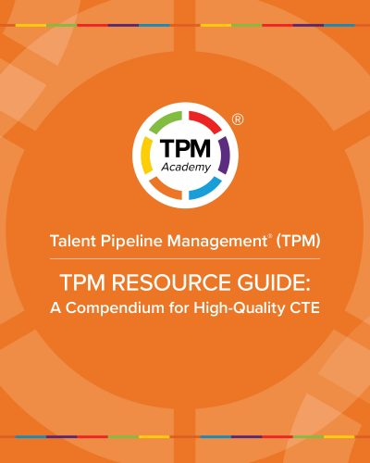
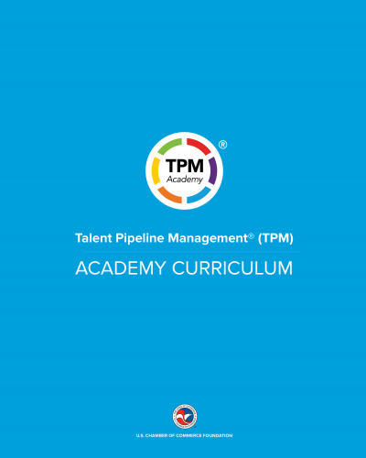
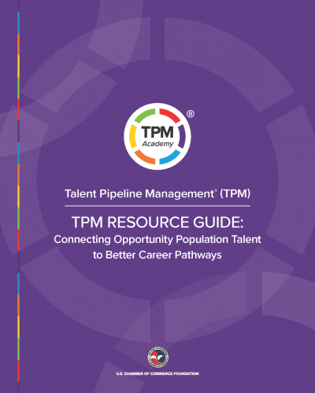
Resources
Notes:
Interest webinar on Thursday 9/21
Next academy starts October 12

Slide 29
Thank you!
Niki DaSilva
Senior Director, Programs & Policy
ndasilva@uschamber.com
Framework: TPMAcademy.org
eLearning: Colab.TPMacdemy.org
Case Studies: ForwardonTalent.org

