Slide 1
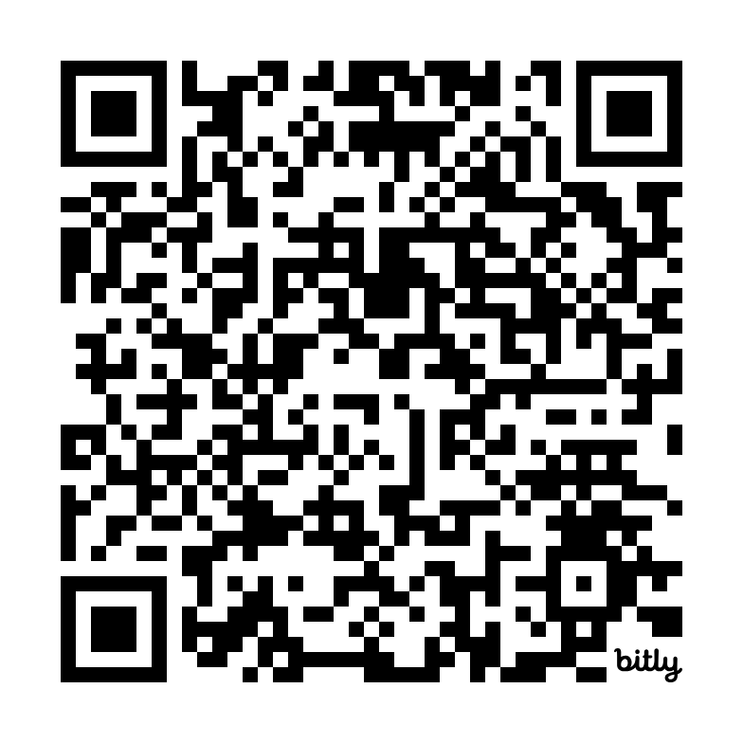


How College Practitioners Can Leverage Data to Drive Institutional Change
2024 CTE Leadership Collaborative Convening
September 24, 2024

Slide 2

The Inquiry Process
Notes:
Font on slide is Arial
Main color is #333333
Sub color is #737373

Slide 3
Shout Out: Supporting Inquiry
What types of information do your colleagues want to look at?
What types of questions do your colleagues have about the data they receive?
What do your colleagues tend to do after reviewing data?

Slide 4
Evidence is critical to inquiry, but not all data are the same
Interesting data: alerts you to an issue or establishes a framework
Report provides students’ perspective on assessment tests
Useful data: provides aggregated information on outcomes that highlights structural issues
Dashboard shows that only 10% of students make it through transfer-level English and math in their first year
Actionable data: provides specific information that can be used to guide service delivery
An assessment algorithm based on which course students previous took and their grades allows colleges to determine the amount of support specific students need to be successful in a college-level course
Dmitri Rogulkin, State Center Community College District

Slide 5
Critical things to know about an inquiry process
Data points and charts are Useful Data—they don’t give definitive answers to questions, but instead point you to areas that deserve study and experimentation
After you augment data points with other sources of information, you still have to decide what specific actions to take
You will need to measure additional factors, at a more granular level, to determine if your change strategy is working

Slide 6
Being an effective data coach
Explain the value proposition for understanding and working with data
Be sensitive to your colleagues’ learning curves with data
Make space for exploring the places where quantitative data does not reflect practitioners’ experienced reality—this can be an opportunity to practice inquiry
Don’t go it alone—make sure you are building a cohort of people who can support data literacy
Honor your local culture, to emphasize working with data in a manner that fits into how your college makes decisions
Research & Planning Group for California Community Colleges

Slide 7
When examining Useful Data for the first time
Create space for people to describe what jumps out at them, from a range of perspectives
Ask people to present hypotheses about why these outcomes are present, and encourage them to develop alternative hypotheses, particularly regarding factors that the college can influence
Determine what you can agree on based on the data, particularly regarding specific action steps
List additional information you need to guide possible action steps, including specifying how this additional information will support action planning
Attend to concerns about methodology, but don’t let these questions prevent a discussion about students

Slide 8
Information that can augment dashboard data for action planning
Create a visual representation of the way work is currently done using a process map, and annotate the map with the major issues or barriers that arise in the work
Create a journey map focused on the arc of a student’s experience over time, and identify the highs and lows, and the reasons for these highs and lows
Conduct focus groups and interviews with students to understand their emotions, thoughts, and needs
Analyze additional quantitative data about the problem to better understand its dimensions
Scan research and relevant literature to find information about the problem or how it may be solved

Slide 9
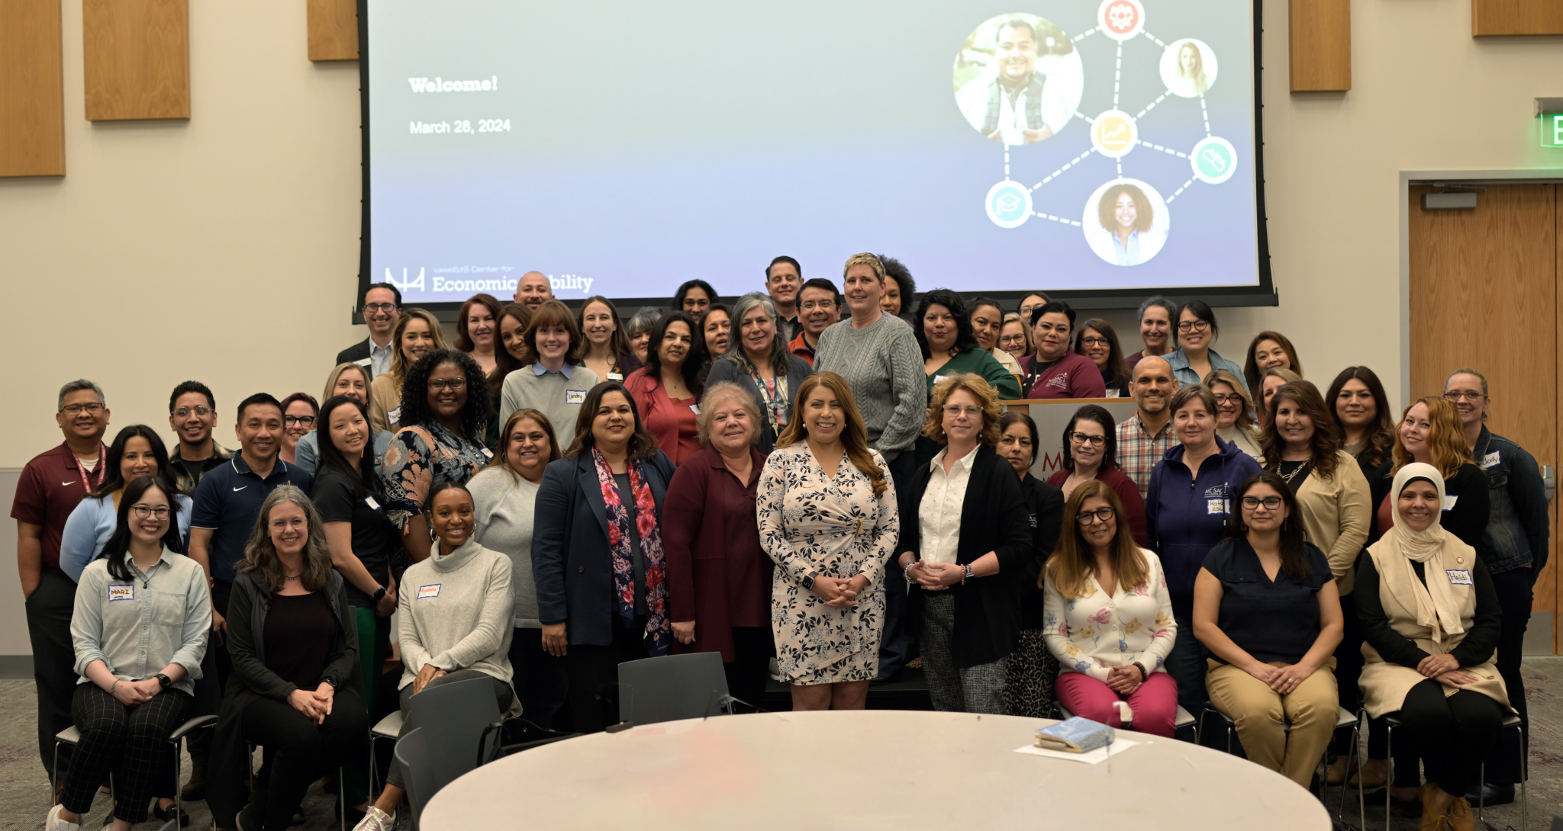
Case Study
Notes:
Font on slide is Arial
Main color is #333333
Sub color is #737373

Slide 10
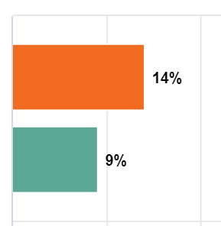
Case Study: Noncredit to credit pathways
Mt San Antonio College in California has a large noncredit program, serving about 18,000 people each year
The college has a much higher rate of transition from noncredit to credit programs, compared to all colleges in the state
They would like these figures to be higher - especially for CTE programs that align with credit pathways

Slide 11
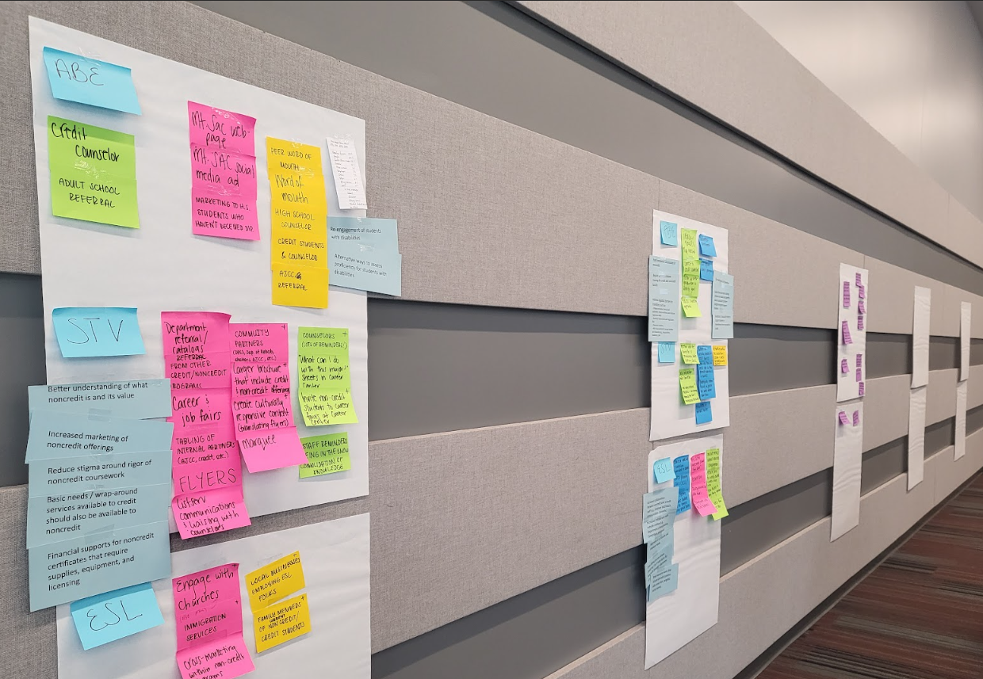
Case Study: Noncredit to credit pathways
Meeting One (most attendees were from the noncredit team)
Reviewed initial data on noncredit to credit transitions based on state-level tools, paired with priority areas of concern gathered through focus groups
Mapped the student journey from noncredit to credit, identified which college systems intersect with those students, and noted sticking points -- and compared the maps to their data
Prioritized several areas where immediate actions could be taken and established teams to do this work
Identified additional information needed

Slide 12
Case Study: Noncredit to credit pathways
Meeting Two (included representatives from across the college)
Shared outcomes of actions taken to achieve the quick wins
Reviewed local data that provided more detailed information at the program level and about different student populations
Developed personas for adult learners
Mapped the process of enrollment, flagged how the process differed for different personas, and identified areas of significant challenge
Determined how existing teams could tackle those challenges and established a new area for action
Identified new research questions

Slide 13
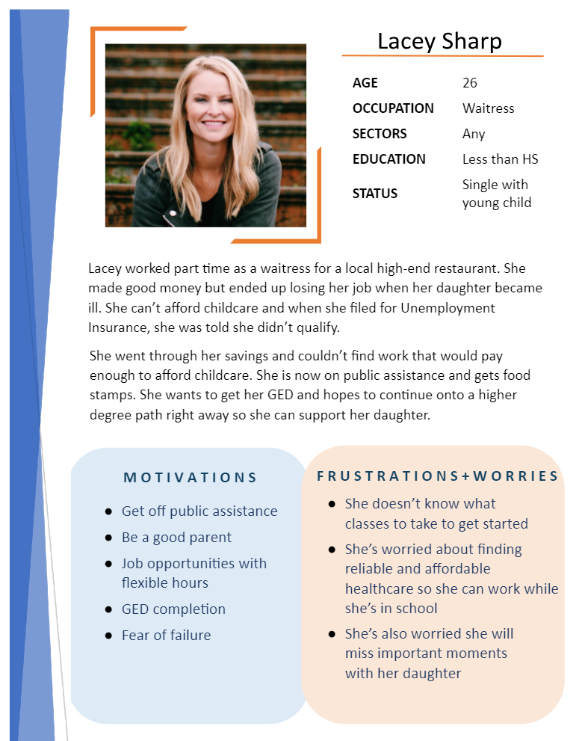
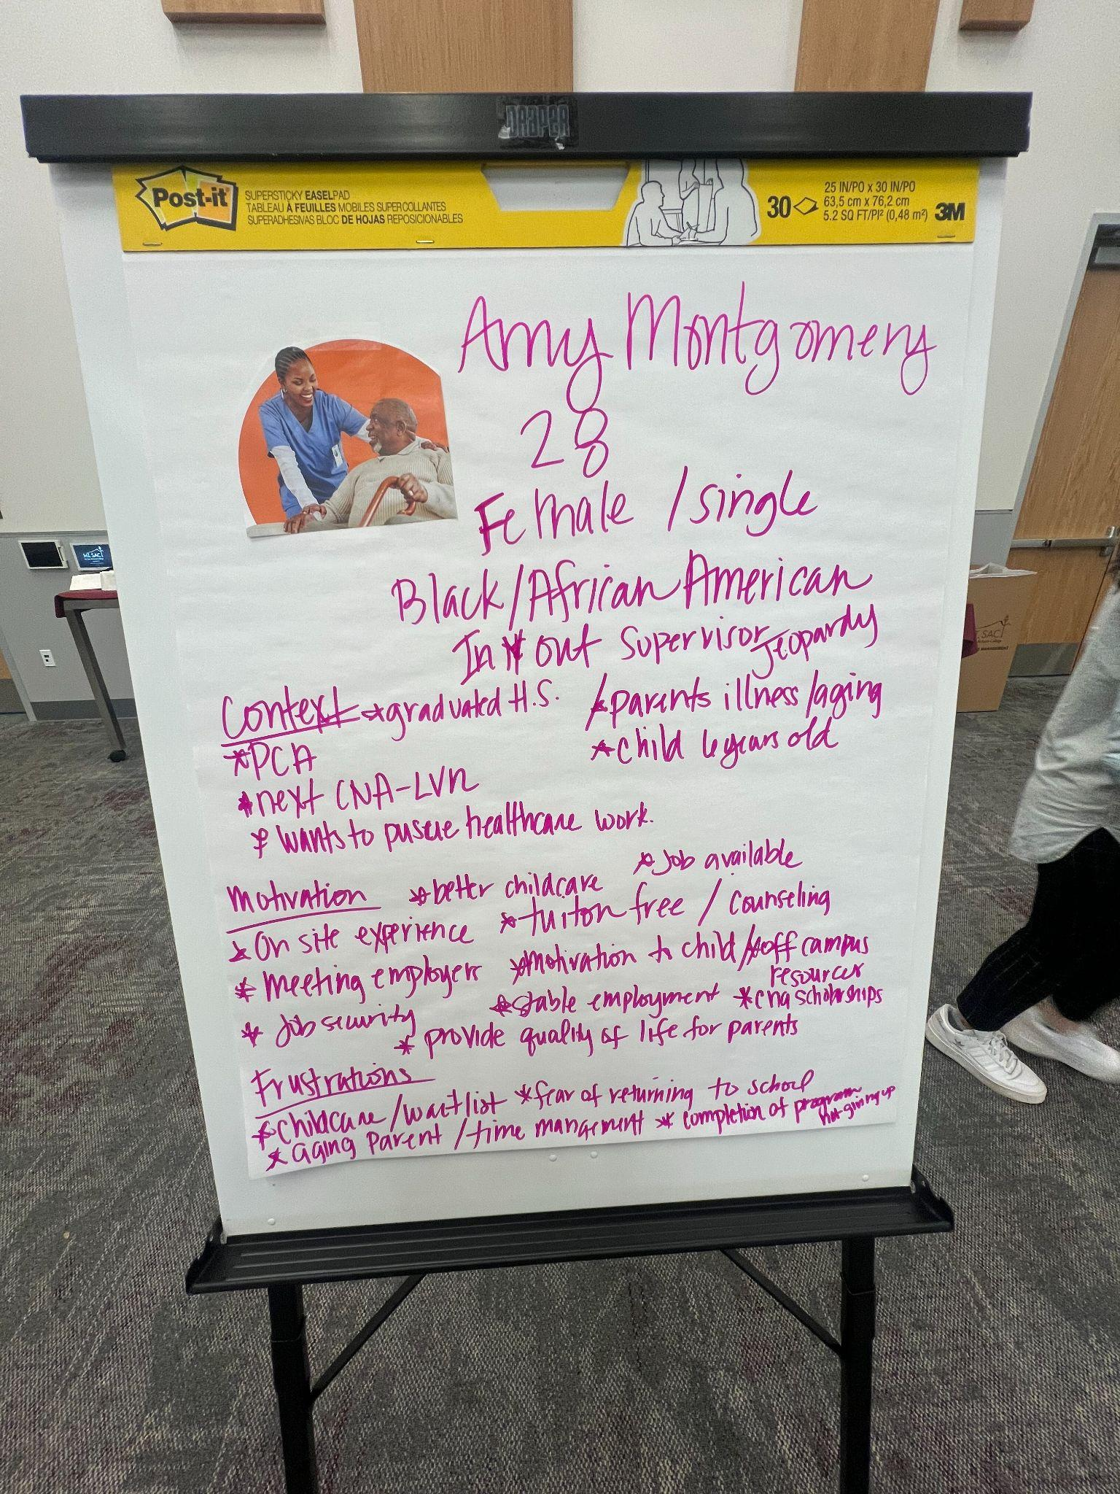

Slide 14
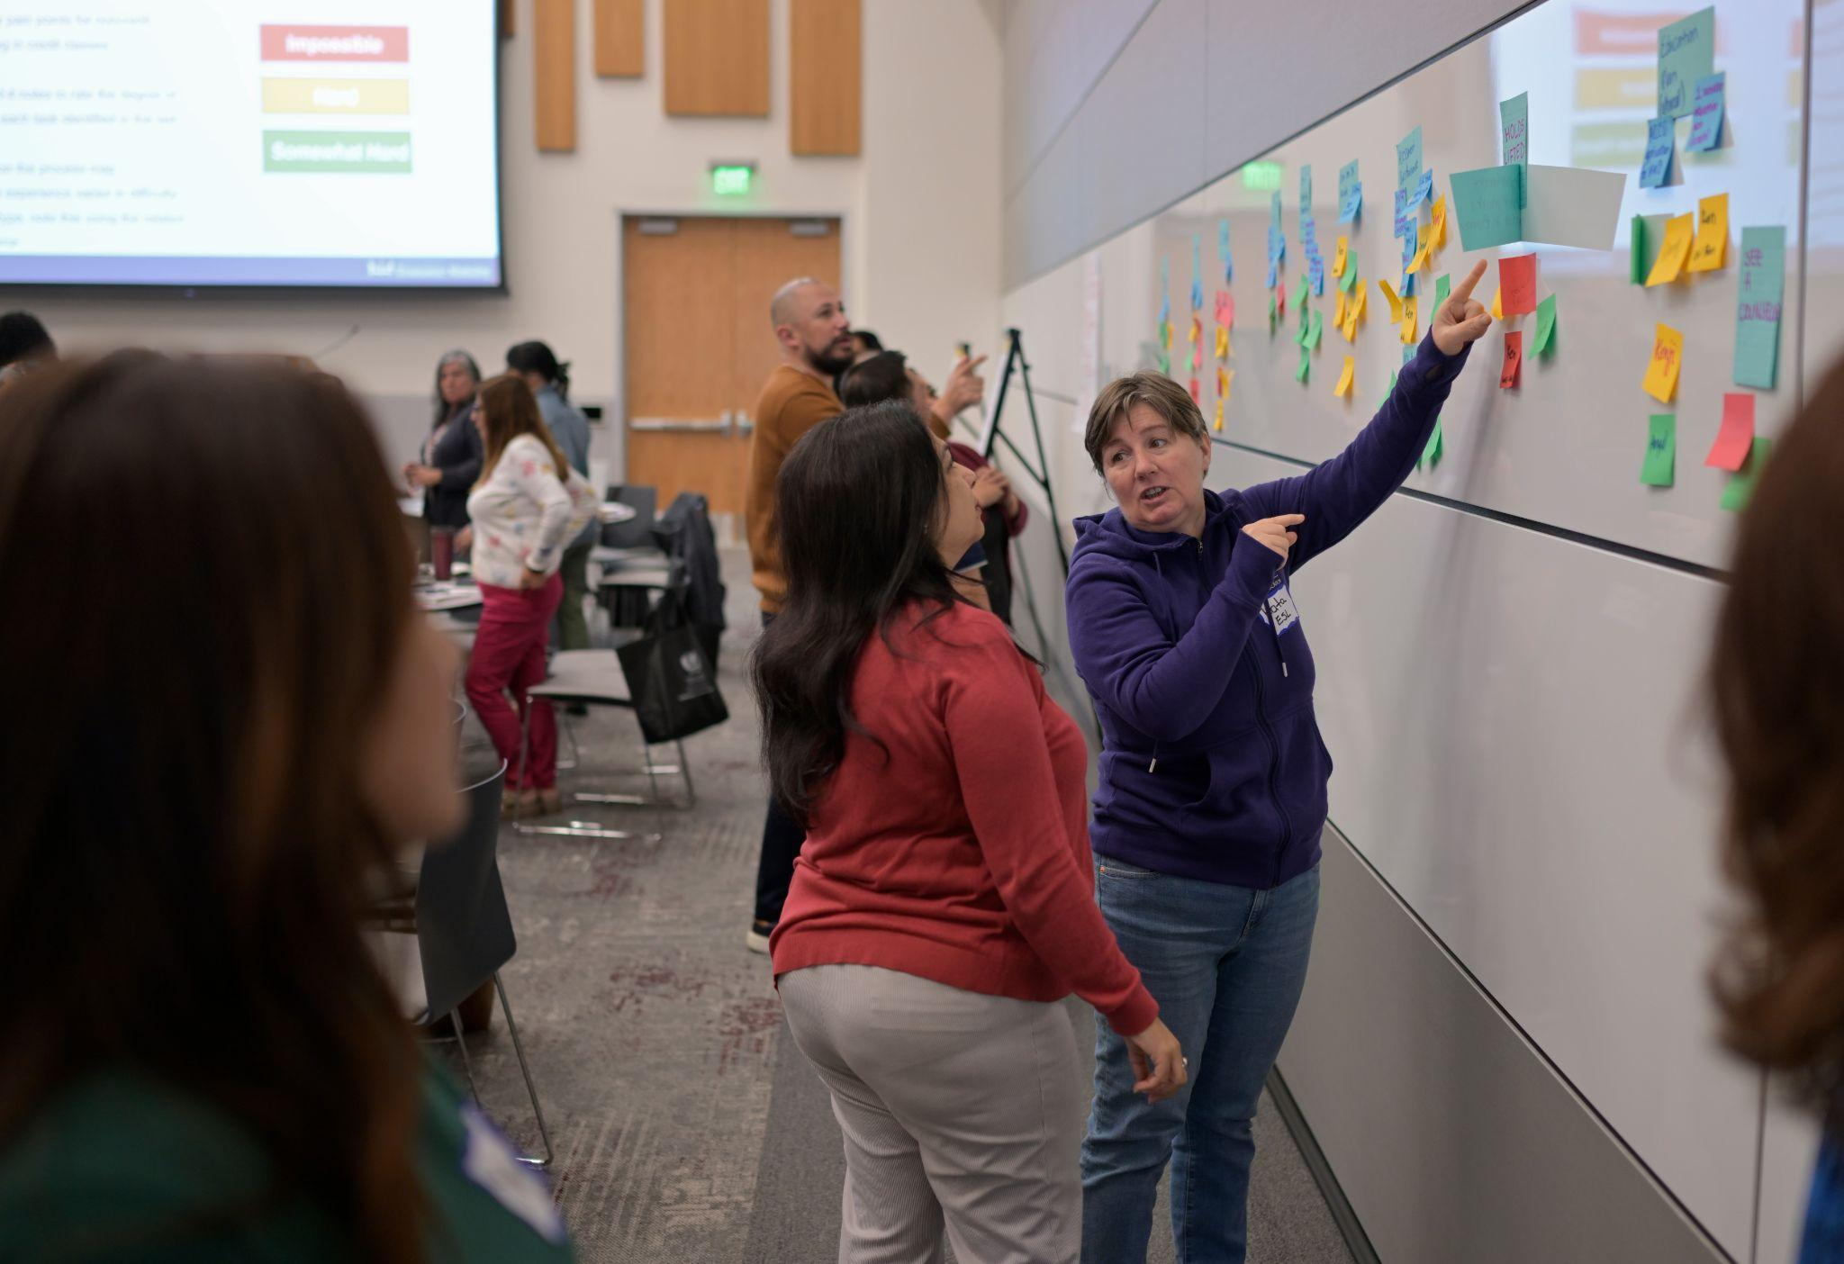
Mapping Process
Step 1: describe the process a noncredit student would follow to enroll in a credit class
Step 2: flag whether the process would be different for various personas
Step 3: indicate the degree of difficulty
Step 4: identify which areas of difficulty to address

Slide 15
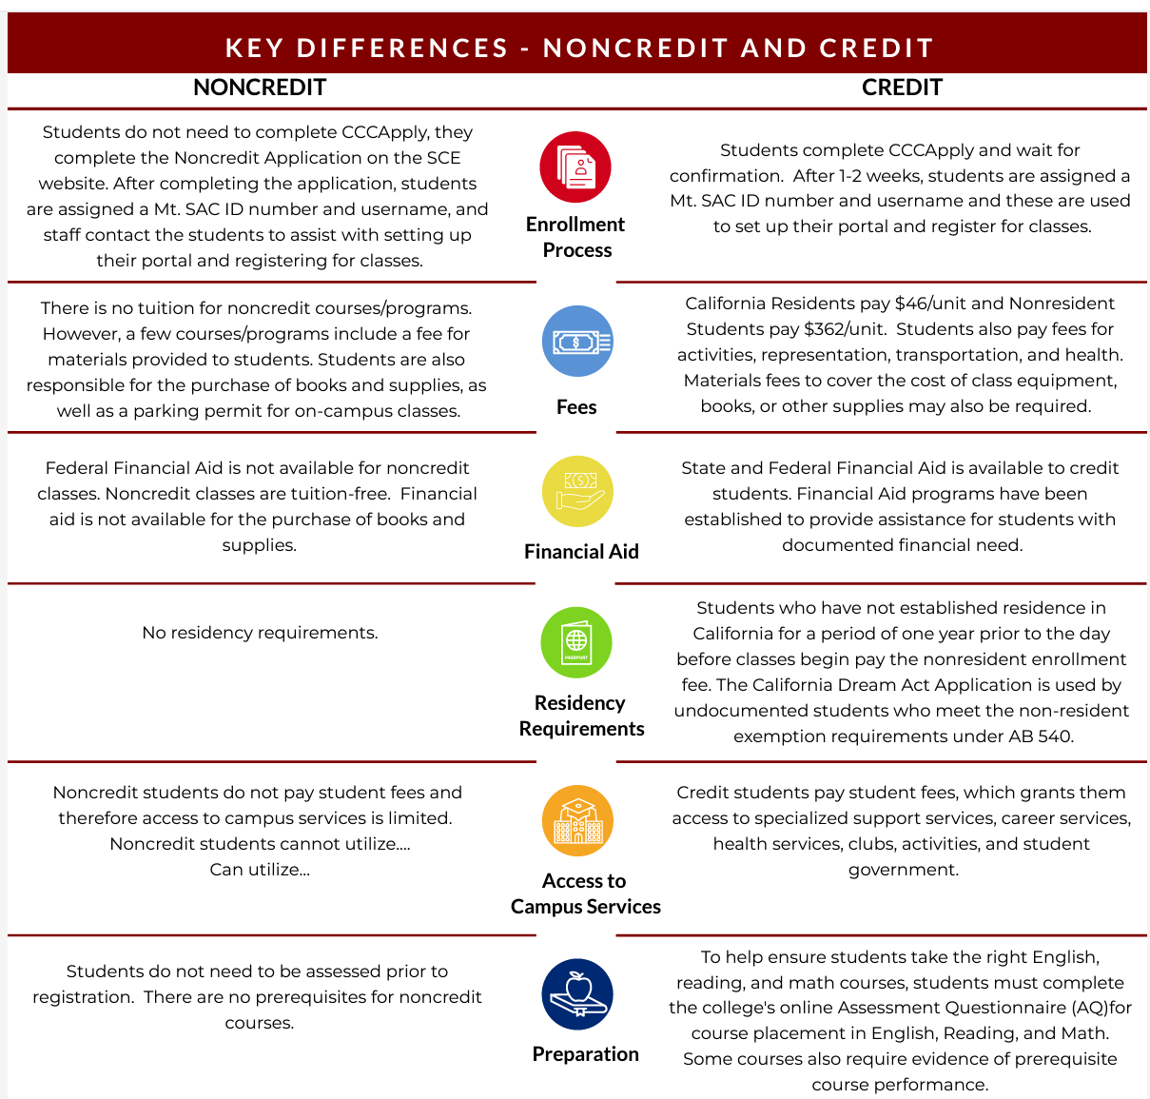
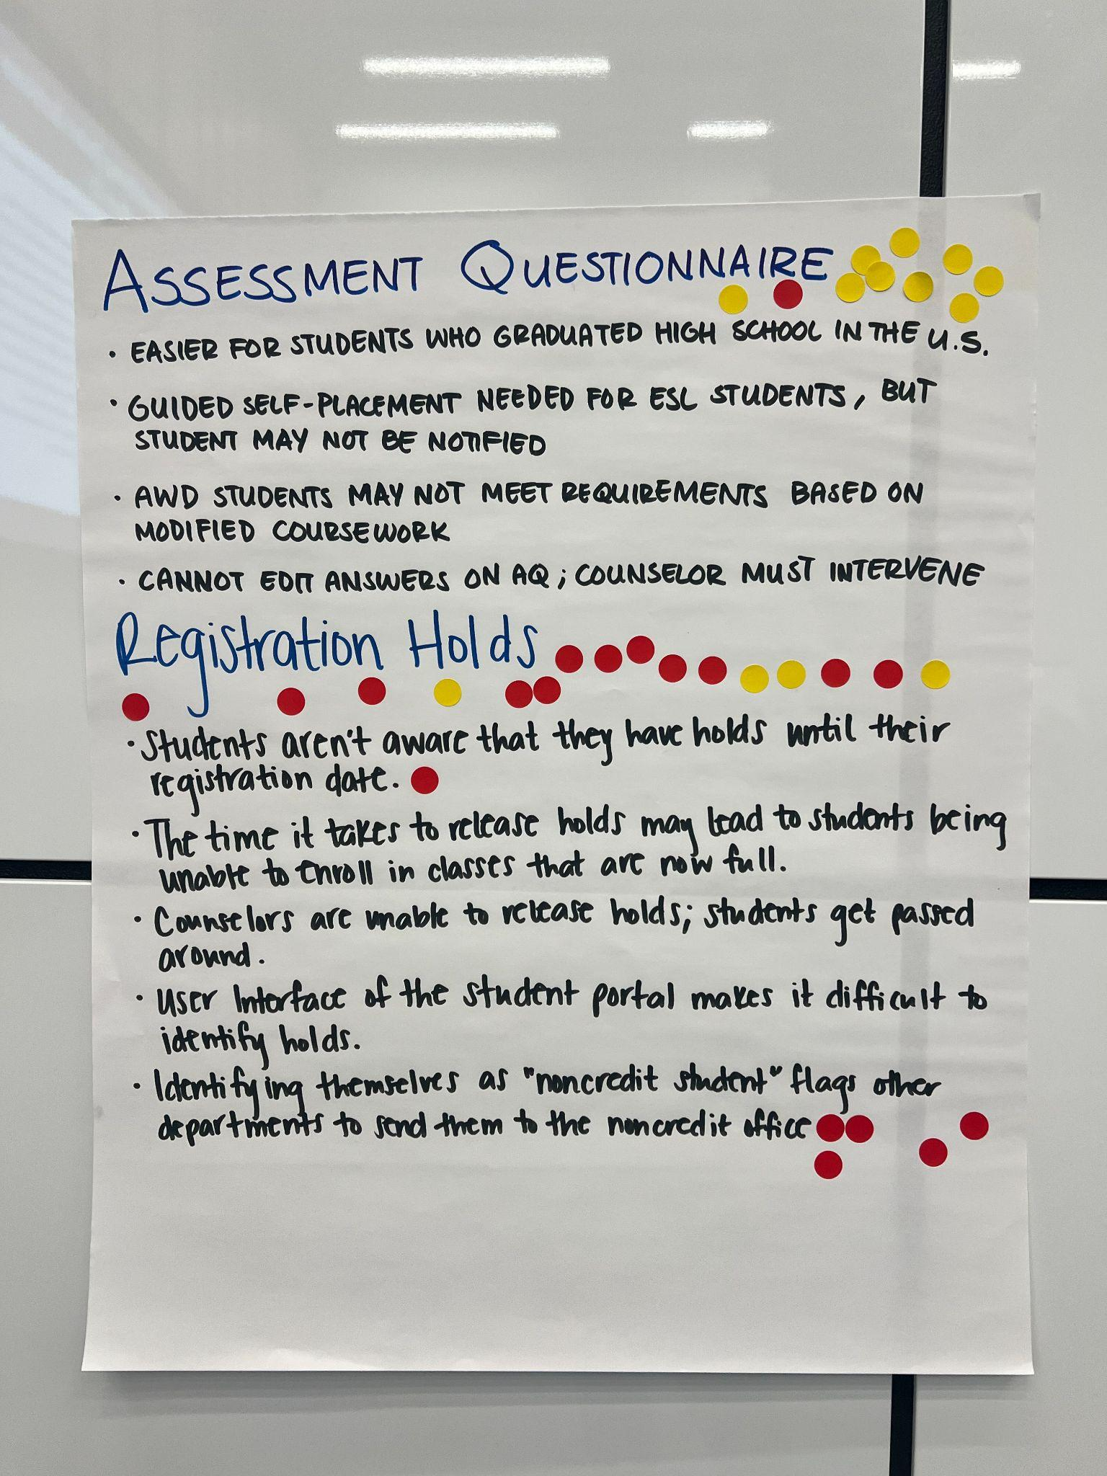
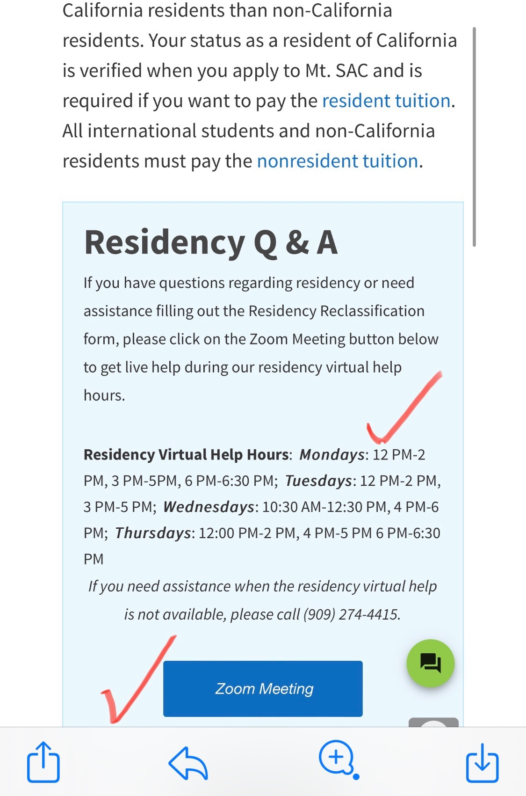
Results
Noncredit practitioners are able to partner more effectively with other parts of the college
New services have been put in place to address a pain point that is shared by credit and noncredit students
Transition Action Group is meeting to address specific priority areas, using a series of focused subcommittees
The research team is digging into a third round of analysis

Slide 16
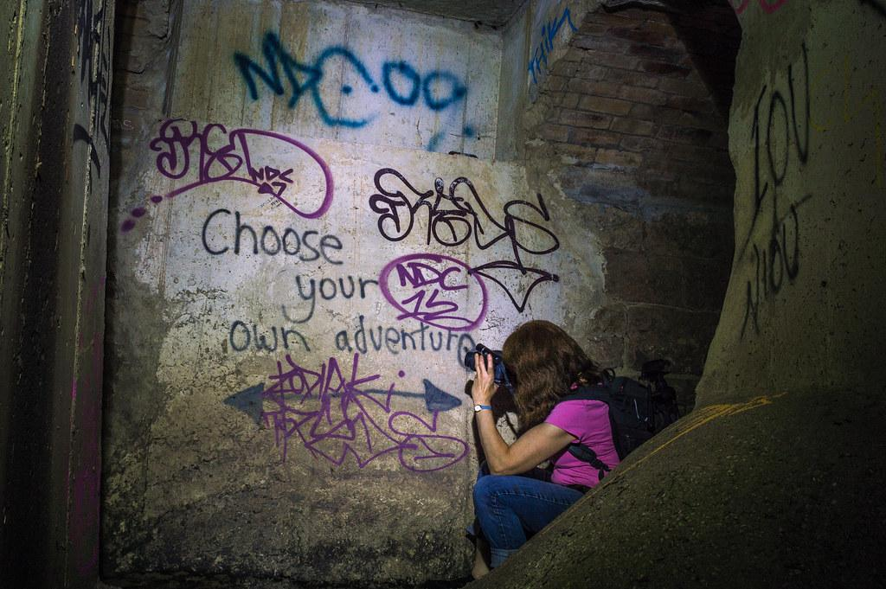
Learn about integrating employment information with academic records
Live Action Analysis
Notes:
Font on slide is Arial
Main color is #333333
Sub color is #737373

Slide 17
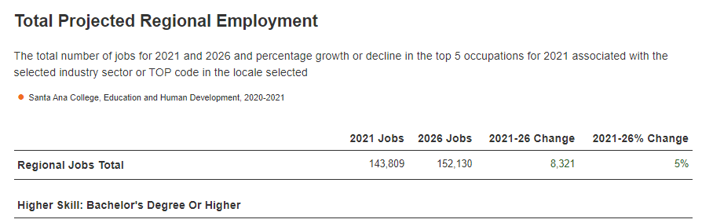
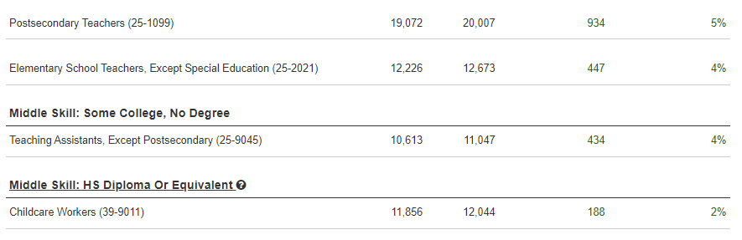
Live Action Analysis: How Can We Strengthen Economic Mobility?
Context:
The region needs more educators
Lightcast Analysis

Slide 18
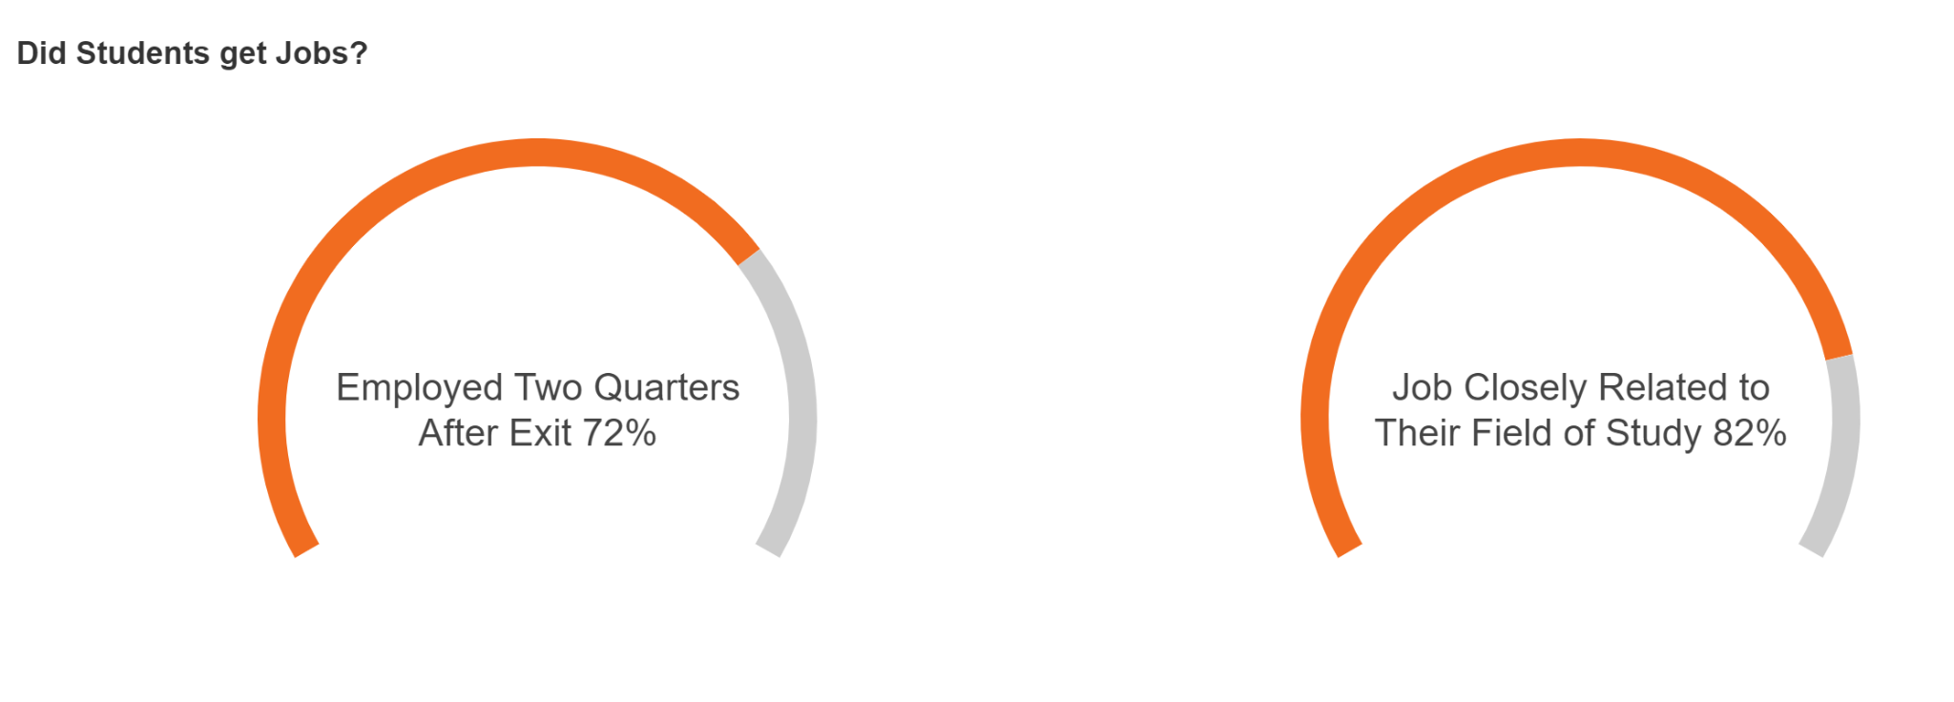
Live Action Analysis: How Can We Strengthen Economic Mobility?
Santa Ana College, Education and Human Development

Slide 19
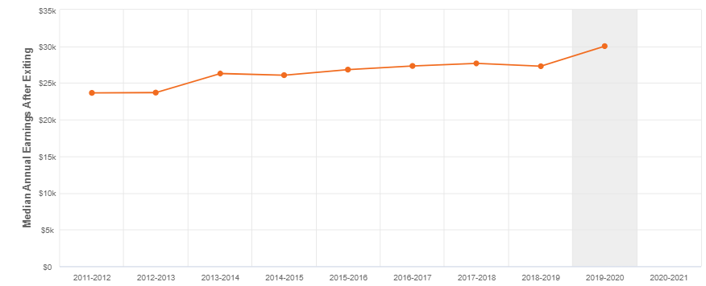
Live Action Analysis: How Can We Strengthen Economic Mobility?
Median Earnings: $30,028
Santa Ana College, Education and Human Development

Slide 20
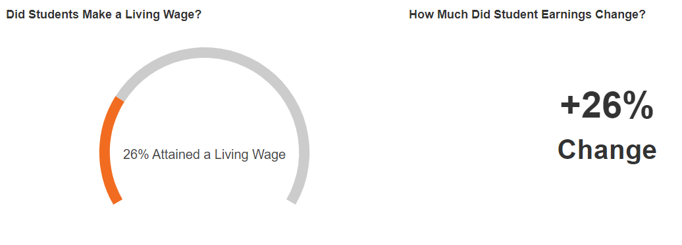
Live Action Analysis: How Can We Strengthen Economic Mobility?
Living wage for a single adult: $42,900
Santa Ana College, Education and Human Development

Slide 21
Live Action Analysis: How Can We Strengthen Economic Mobility?
What do you notice about these figures?
What hypotheses or explanations do you have about what you see?
What do you agree on?
What additional information do you need?
What actions are you ready to take?
Additional information sources:
Process map
Journey map
Focus group
Quantitative analysis
Literature/best practice review

Slide 22
Live Action Analysis: How Can We Strengthen Economic Mobility?
This information could be used to discuss issues such as:
What are the expected earnings for this occupation and industry?
What factors contributed to students earning more over time?
How has the increase in earnings affected students? Did other employment conditions change, such as more consistent hours, more hours, or access to benefits?
What advice should we offer to students about potential earnings?

Slide 23
Live Action Analysis: How Can We Strengthen Economic Mobility?
Common challenges when discussing economic outcomes:
Where did you get this information? That data set is incomplete/unreliable!
I know there are more jobs our students get
Those wages are too low
You are focusing too much on money as the value provided by a job
You are making it look like some majors are better than others
I can’t control what employers want, and often what they want isn’t best for our students

Slide 24
https://bit.ly/ecmc-cte-leaders-data-use
“Next Level Data Disaggregation” - a discussion guide based on the types of information you might choose to include in dashboards you are building
Worksheet for building personas and an example finished product
Sample facilitation agendas for initial and deeper-dive meetings on noncredit to credit transitions
Answers to common concerns about labor market information
This slide deck
kbooth@wested.org
Resources
Notes:
Font on slide is Arial
Main color is #333333
Sub color is #737373

