Slide 1
Up-to-Date with DATE
CTE Data Collection Under Perkins V
Adam Flynn-Tabloff
Chief, Program Administration and Accountability
ECMC Collaborative Convening – September 24, 2024

Slide 2
Session Objectives
Participants will:
  Understand how Perkins V funds career and technical education (CTE) at the postsecondary level
  Identify trends in postsecondary CTE enrollment and performance outcomes under Perkins V
  Know proposed changes the Department is seeking related to its two primary information collections: (1) the State Plan Guide; and (2) the Consolidated Annual Report.
  Understand implications of the proposed changes for States and local recipients of Perkins funds.
  Access resources that are available to assist in telling the story of CTE’s positive impact on students’ lives.

Slide 3
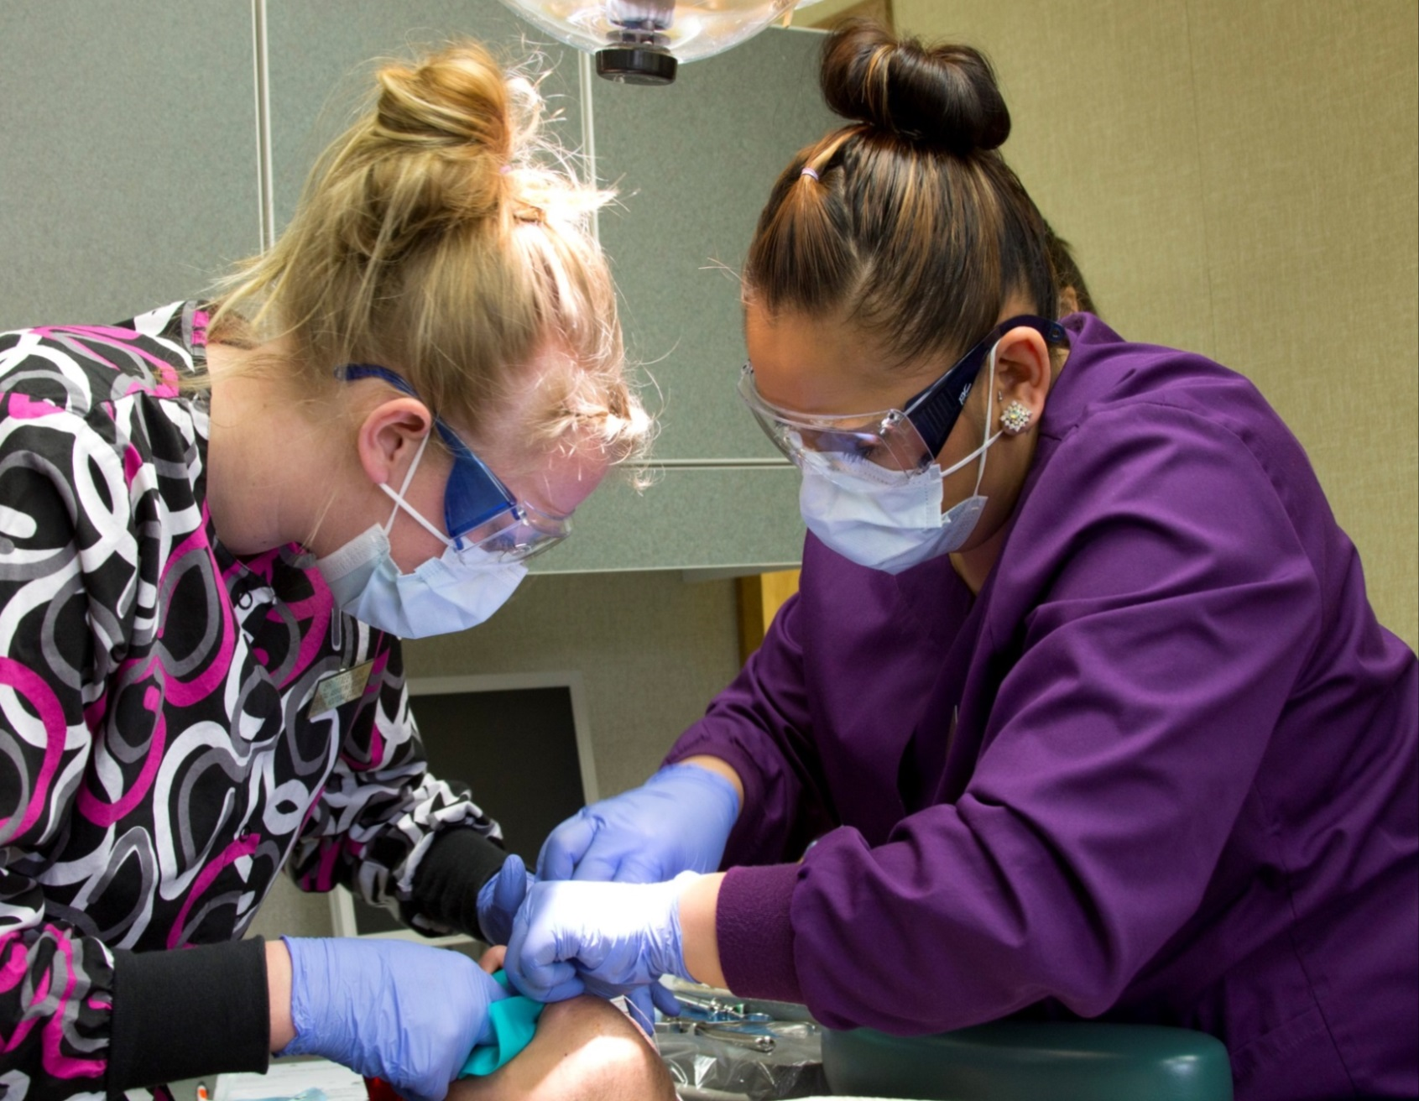
Perkins V - Vision
Expand opportunities for every student to explore and follow a career pathway to earn credentials of value and meet local workforce needs.

Slide 4
Perkins V – Postsecondary Funding
Total Perkins V allocation: $1.4 billion in FY2024
  National average of 38% of funds allocated to postsecondary recipients totaling roughly $413 million
  Determining the split of funds between secondary and postsecondary recipients is a key decision for each State
  Formula based on Pell counts or a “more equitable distribution” method approved by ED.
  Minimum allocation is $50,000
Eligible postsecondary recipients submit local applications for funding to support CTE programs of sufficient size, scope, and quality.

Slide 5
Perkins V Data - Enrollment
Enrollment Data (Secondary & Postsecondary)
CTE Participants
Gender
CTE Concentrators
Gender
Race/Ethnicity
Special Populations
Career Clusters
Race/Ethnicity
Special Populations
Career Clusters

Slide 6
Perkins V Data - Performance
Performance Data
Secondary Level
7+ Indicators
Postsecondary Level
3 Indicators
Gender
Race/Ethnicity
Special Populations
Career Clusters
Gender
Race/Ethnicity
Special Populations
Career Clusters

Slide 7
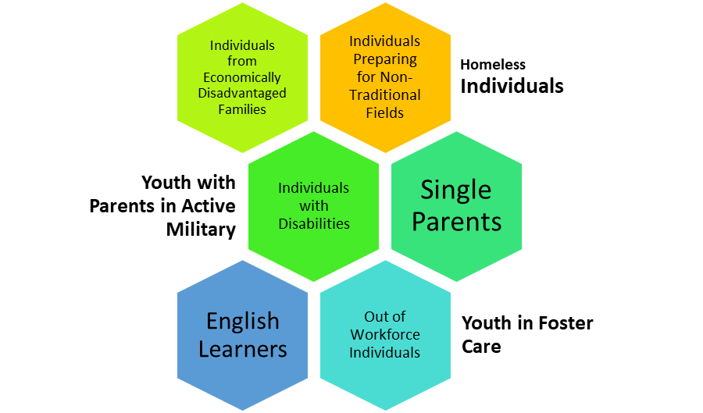
Disaggregated Categories
Special Populations
Career Clusters
Agriculture, Food, and Natural Resources | Architecture and Construction | Arts, A/V Technology and Communications | Business Management and Administration
Education and Training | Finance | Government & Public Administration | Health Science
Hospitality and Tourism | Human Services | Information Technology | Law, Public Safety, Corrections, and Security
Manufacturing | Marketing | Science, Technology, Engineering, and Mathematics | Transportation, Distribution, and Logistics

Slide 8
Currently Available Data
State Profiles
Enrollment data for 4 years.
Performance data for 3 years.
National Summary and Profiles for all States.
Dynamic dashboards to dive into disaggregated data.
Perkins Data Explorer
Run custom reports to produce raw data files that can be exported to Excel.

Slide 9
Participants for Program Years
2007-08 to 2022-23

Slide 10
Concentrators for Program Years
2019-20 to 2022-23

Slide 11
Characteristics of CTE Participants
Program Year 2022-23

Slide 12
Characteristics of CTE Concentrators
Program Year 2022-23

Slide 13
Postsecondary Concentrator Performance - Program Years 2020-23

Slide 14
Improving CTE Performance Measurement and Data Collection
Better performance data will equip the Department, States, and local recipients with information to improve our CTE programs to meet the needs of students and employers
Greater support has the potential to address many of the challenges faced by CTE

Slide 15
Perkins V – Information Collections
State Plan Guide
  State Plans
  Plan Revisions
  State Determined Performance Levels (SDPLs)
Consolidated Annual Report
  Enrollment data
  Performance data
  Fiscal information
Alignment with the Law
Promote Consistency in Reporting
Fill Information Gaps
Inform if Future Rulemaking is Appropriate

Slide 16
Proposed Changes
State Plan Guide
New narrative items
Numerator and denominator specifications
Consolidated Annual Report
Further disaggregation of post-program placement
Middle grades participation
New narrative items

Slide 17
Why Common Numerator/Denominator Specifications?
1. Promote measurement of indicators that is consistent with the law
2. Limit the collection of potentially duplicative information
3. Improve the accuracy and completeness of data on post-program outcomes
4. Improve the consistency of State data

Slide 18
Post-Program Placement (1P1)
3. Improve Accuracy and Completeness
Give States 16 months (i.e., an additional program year) to gather data on post-program outcomes of CTE concentrators

Slide 19
Attainment of Recognized Postsecondary Credential (2P1)
1. Consistency with Law and
4. Improve Consistency of State Data
Specify that the denominator include CTE concentrators at the postsecondary level enrolled in the reporting year who completed a CTE program during the previous reporting year

Slide 20
CTE Concentrators in Non-traditional Fields (3P1)
4. Improve Consistency of State Data
Specify that denominator is the number of CTE concentrators who are concentrating their studies in a CTE program/program of study that leads to a non-traditional field, not all CTE concentrators.
Specify that students in the numerator/denominator are those CTE concentrators who are concentrating their studies in a CTE program/program of study that leads to non-traditional fields.
Specify that the numerator is the number of CTE concentrators from the minority gender in CTE programs leading to non-traditional fields.
Specify that CTE concentrators from the minority gender in CTE programs that lead to non-traditional fields are included in the numerator in the reporting year in which they meet these criteria

Slide 21
Implementation Timeline
State Plan Changes
Required to be addressed in FY 2026 State Plan Submission
Numerators/Denominators utilized for program year 2026-27
Consolidated Annual Report Changes
Required to be addressed in January 31, 2028, submission for program year 2026-27

Slide 22
Implications for States and Locals
States
FY26 State Plan submission must address new narrative items and include SDPLs based on numerator/denominator specifications
May require SDPL revisions
May require local levels of performance renegotiation
May require amendment procedures
FY26 CAR submission must provide performance data based on numerator/denominator specifications
May impact trend data under Perkins V
Locals
Program year 2026-27 performance data must be based on numerator/denominator specifications
May require renegotiation of local levels of performance
May impact trend data under Perkins V

Slide 23
Provide Feedback on Proposed Changes
Both information collections with proposed changes are currently available for review and public comment on the Federal Register
Initial 60-day public comment period ends on November 12, 2024.
Check the Perkins Collaborative Resource Network (PCRN) at cte.ed.gov for more information.

Slide 24
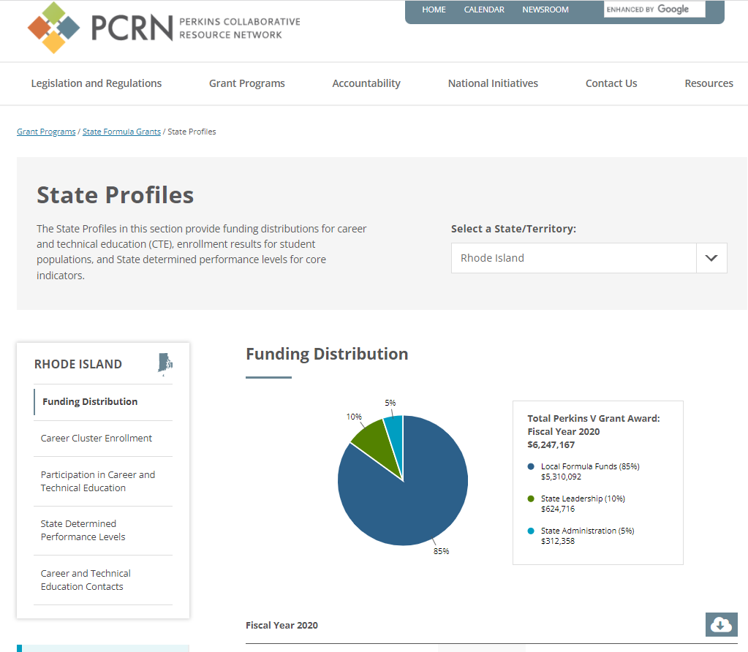
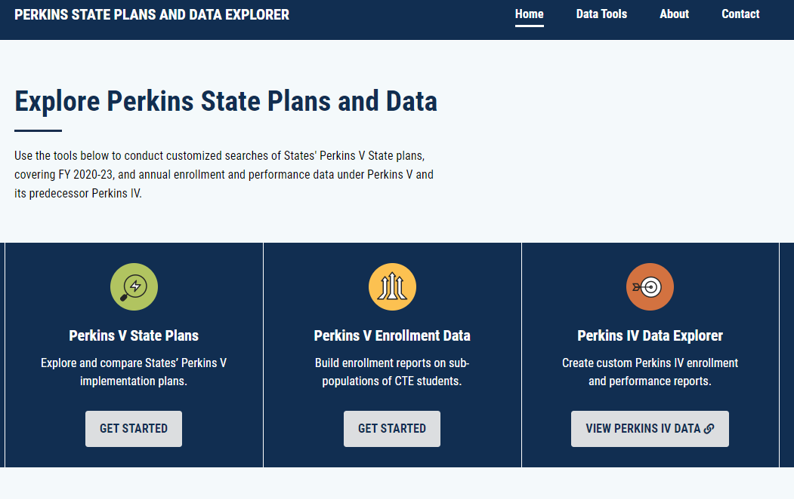
Perkins Collaborative Resource Network
Regularly visit cte.ed.gov to stay up to date with DATE
Notes:
To help you get involved and to spread the word - I want to highlight some valuable resources that are available to you.
Our website - the Perkins Collaborative Resource Network (PCRN) is full of valuable information, resources, and opportunities for engagement - but there are two particular components to highlight today.
First is the State Profiles and National Summary. Each State has a profile that summarizes its most recently submitted Perkins budget, career cluster enrollment, CTE participation rates, and performance data for CTE concentrators. The public has access to robust and dynamic data dashboards that allow for deep analysis of CTE enrollment and performance data at the national and State level and this data can be disaggregated by all special popualtions of students.
The PCRN also houses the State Plans and Data Explorer. This tool allows public users to generate customized enrollment and performance reports for any states in the country or for the nation as a whole. Also, there is a searchable database that allows you to pull out particular parts of States submitted Perkins State Plan.
I recommend visiting the PCRN regularly to stay up to date with all things Perkins.

Slide 25
Questions?
Adam.Flynn-Tabloff@ed.gov

