Slide 1
Promise and Peril
CTE
Yesterday, Today, Tomorrow
Jeff Strohl
September 24th, 2024
ECMC Foundation
CTE Leadership Collaborative Convening
Chicago

Slide 2
Check all that are true
          CTE is weighed down by a history of tracking by race and class that goes back to its inception with the Smith-Hughes Act of 1917
          CTE has successfully broken from its vocational education past, is no longer anchored in the old economy, and has successfully become attuned to the modern economy with new programs
          CTE tracks students into middle skills segregating these graduates from more economic opportunity and mobility because of limited transfer to the BA
          CTE obtains better outcomes for concentrators

Slide 3
The challenges before CTE
Training is not seen as equal to education
CTE is discredited while the nation wants it to step up as evidenced by the calls for skills-based hiring, the specter of skills shortages, and the concern college isn’t worth it.
CTE and CTE practioners deserve a call out.
I have seen more innovative approaches to teaching, and workforce preparation, in the community colleges than in the four-year institutions – in part because community colleges are more likely to embrace their workforce development role.
Yet, major inequities are correlated with community colleges.

Slide 4
 | 2-year (2019 cohort 150% time) | 4-year 2016 cohort (6 year) |  | Non CTE | 2 credit | 3 credit
all | 34% | 65 | any pse | 69 | 68 | 66
W | 38% | 68 | cert/AA | 15 | 20 | 24
B | 25% | 46 | BA | 54 | 48 | 42
H | 31% | 59 | no known | 32 | 32 | 34
digest of ed stats. - various tabs

Slide 5
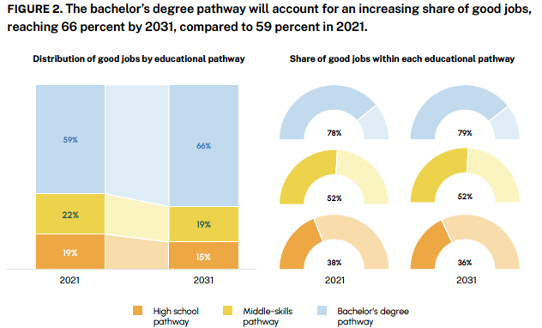

Slide 6
Whites have skipped over the middle which, I believe, drives some on wage and income
Inequality
Jobs in millions, chage 1991-2016
 | Job change | Good jobs | HS good jobs | Middle good | BA good
White | 1.9 | 7.5 | -3.8 | 0.7 | 10.6
Black | 4 | 2.4 | -0.2 | 0.7 | 1.9
Latino | 13.1 | 5.4 | 1.8 | 1.4 | 2.2

Slide 7
CTE has to deal with the “Good enough problem”
Is it bad to improve outcomes for some students while other students do much better?
Why is my son not enrolled in post-sec CTE?

Slide 8
Yesterday
(all my troubles seem so far away)

Slide 9
CTE is damned by the ghosts of the past
Article after article points to the legacy of race and class tracking.
Our system shuffled lower performing students into low quality programs with low quality outcomes.
“College for all” came to mean my children went to college and the other kids went to trade school with little prospect of upward economic mobility.
(e.g. Holzer and Baum, Overcoming the Stigma of Voc Ed In Today’s CTE, Future Ed, 2017)

Slide 10
Today

Slide 11
Recent 2024 evaluation of CTE demonstrates a new story
“Overall, CTE participation … positively impact a number of secondary-level outcomes,
Including high school completion;
Increases enrollment in 2-year colleges; and
Positively impacts the likelihood of employment after high school.
For CTE programs generally, no statistically significant negative impacts.
This is welcome news for the field and policymakers alike and can serve as further justification for bipartisan support for CTE.
High school CTE can be an effective dropout prevention program that motivates graduates to continue their education in community and technical colleges and/or prepares them for immediate employment. “
Lindsay, J., Hughes, K., Dougherty, S. M., Reese, K., & Joshi, M. (2024). What we know about the impact of career and technical education: A systematic review of the research. American Institutes for Research, Career and Technical Education Research Network.

Slide 12
Tomorrow

Slide 13
“There is no evidence … to connect CTE to
enrollment in 4-year colleges,
college persistence and degree attainment, or
wages.
Given […there are] positive impact on college readiness, …[the imperative before CTE is to be] better designed to prepare students for and lead to the full range of postsecondary options.
In addition, state and district CTE administrators should ensure that CTE programs are offered in fields that lead to living-wage employment directly out of high school or after earning a subbaccalaureate credential.
… There is national consensus that employability skills are critical to success in the workplace, highlighting a need for further studies on CTE’s role in imparting these skills….”
, [ibid]

Slide 14
The promise

Slide 15
The nation needs serious investment in CTE
which the public supports.
Until faced with the fact it costs money

Slide 16
CTE is small bore, not because it is flawed, - but more so because we drastically underinvest in training.
Currently we invest about 1/4th of the $ we did in 1980 and this doesn’t account for growth in the size of the labor force.
To Paraphrase Holzer – we have been on a downward spiral where low funding feeds low performance which feeds low funding.
Our investments in CTE are so small in terms of percentage of GDP that in comparison to many OECD countries we don’t register as having serious vocational education.
Just think, the statistics on CTE start with participation as one CTE class in all of high school and ‘concentrator’ as 3 classes. Average participation is 10% of credits –
gosh how can we expect CTE to move the needle at this level especially with credits nearly halved from historic highs. Capellli (2014)

Slide 17
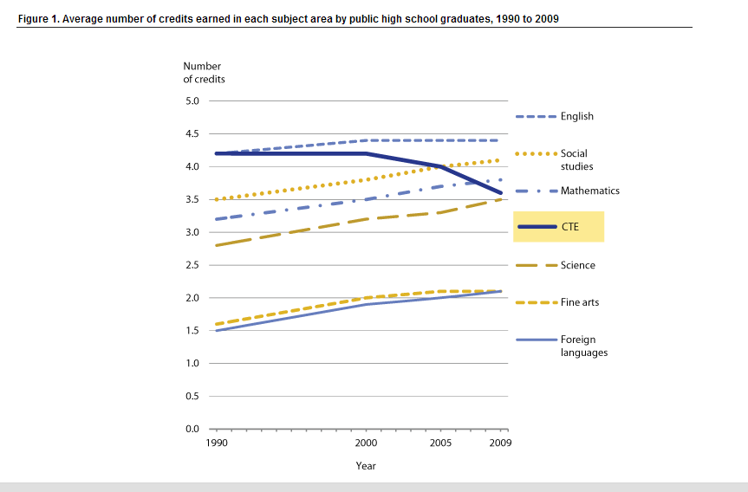

Slide 18
I propose a name change to ‘Occupational Preparation’
90% of college students are in school to get a job
70% of all post secondary programs are focused on occupational preparation but I don’t think all of this is seen as formal CTE
10% of high school credits are in CTE.
Something is wrong – and I am convinced its not the fault of CTE programs or faculty – Everyone I’ve met in technical colleges and post-sec CTE are really on top of their game.
Are CTE students less likely to go to 4-year institutions because they are doing well, because of structural issues (e.g.transfer?)or because of low-expectations?(McKinley Tech story)

Slide 19
We need
Appreciation theat EVERYONE uses training – its not just young people – average apprentice age is around 30 – not 21
Education Level | Share with certificate and certification/license | Share with certification/license only | Share with certificate only | Share with neither | Total
Less than high school | 1% | 6% | 3% | 90% | 100%
High school diploma | 3% | 14% | 8% | 75% | 100%
Some college | 8% | 18% | 14% | 60% | 100%
Associate's degree | 9% | 28% | 13% | 49% | 100%
Bachelor's degree | 3% | 28% | 6% | 62% | 100%
Graduate or professional | 4% | 48% | 3% | 45% | 100%
AA+ | 5% | 34% | 7% | 55% | 100%
BA+ | 3% | 35% | 5% | 56% | 100%
2016 ates

Slide 20
We need:
Clear and effective transfer policy and guidance linking HS-2 year -4 year
We need honest assessment of economic opportunity in the middle skills space.
President Biden’s Proclamation about middle skills jobs paying 130k Plus, doesn’t help anything - only 3.2% of middle skills jobs are 130k+ (BA+ are 17.1%)
The middle skills space will be fairly stable
We need more fully articulated ‘career pathways’ that work
“ [C}areer pathways programming and resources are often focused on the initial steps of a career pathway, which typically lead to entry-level jobs, often with low wages. Little is understood about how programs can support career advancement to fulfill the promise of career pathways that lead to jobs that provide a stable career and family-sustaining wages. ”
Fullfilling the Promise of Career Pathways, Eyster and Gebrekristos, OCT 2018 – Urban ( echoed in recent ABT meta eval)
Lastly, alignment.

Slide 21
Using Labor Market Data to Align programs to demand.
Improve data systems
Invest in robust evalution of career mobilty

Slide 22
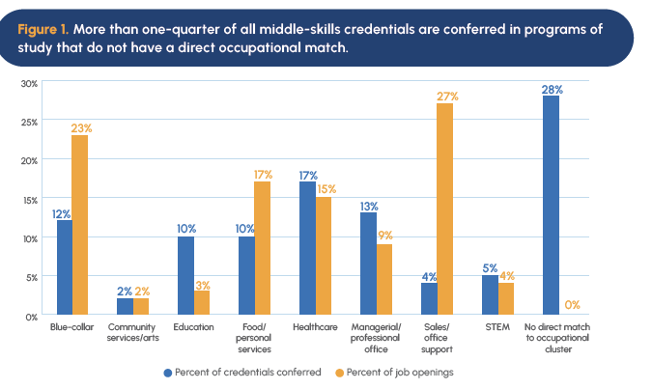

Slide 23
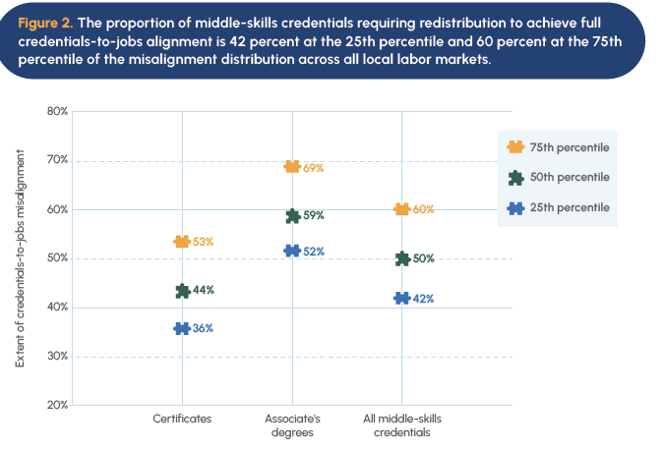

Slide 24
Trends and implementation

Slide 25
Three important national trends :
Skills based hiring – education and training builds skills and are not empty signals. The complexities of the global economy and upskilling demand more- skills based hiring should be seen as the demand for clear alignment between education and training and jobs.
College isn’t worth it – we should always ask if we are getting our monies worth, but a blanket statement that all education past high school is a bad bet is as wrong minded as saying that college is a panacea. NO, the answer is in the middle, as we will discuss – better alignment is needed.
Workforce Pell –promises to legitimize training – but we need double down on accountablity
Alignment can help address these issues

Slide 26
What is the issue with some college, no degree and why we need to sort this out
Dumping ground for everything that we didn’t think was important yesterday, and sure wish we had a handle on now. Much of which happens in, or is adjacent to the community college (nationally)
This includes:
Non-credit
Training
Apprenticeship
Certifications
Work-based learning
Formal customized employer-provided training
OJT
The lack of these data hold us back from:
Separating the wheat from the chaff (+/- ROI)
Understanding non-linear human capital development
Measuring full-impact of human capital investments
(note also: occupation on wage record data)
Skill-building
Skills-based hiring (in part)
Roughly 50% of some college, no degree brings a significant wage premium

Slide 27
Smell test versus the t-test
Data should inform our decisions – not dictate our decisions
Qualitative data is critical – numbers do not exist in a vacuum- context is critical
Employer partnerships are important for multiple reasons:
Stakeholder engagement and buy-in ensures good ideas become real actions
Employers have information that is needed to better inform what curricula should target
Employers need to be in the long game- currently skills shortage discussions are often about spot-market issues that the community college can’t easily pivot to invest in
On the other hand (”just give me a one-handed economist” –Harry Truman), Quantitative data provides long and deep view and should really inform discussions and tool development while always being put to the smell test.

Slide 28
Forward investments
We need to continually aim to modernize our data systems but be wary of bells and whistles.
Data systems should:
Provide ways to align our education investments with projected education demand. CEW is working on this, but ultimately it needs work with your ground level data in conjunction with informed stakeholder involvement.
Provide skills information to better align curricula with workplace needs while not over-investing in just technical skills because this overinvestment lowers flexibility in the face of local and global change ( converging).
Include occupation as this is critical to evaluating education and training investments.
Engage employers to provide data that will improve the ability of education and training to react to labor market needs and changes
Provide evidence whether, how, and what human capital investments are sound. Data systems need a strong business argument so all the state’s stakeholder buy in to this long-term investment.

Slide 29
Thank you
Feel free to reach out with questions and suggestions.
Js787@Georgetown.edu

