Slide 1


Evolving Attitudes Around Equity – What This Means for CTE
ECMC Foundation’s CTE Leadership Collaborative Convening
Brittany H. Brady, Ed.M., CAP®
National Alliance for Partnerships in Equity
Napequity.org

Slide 2
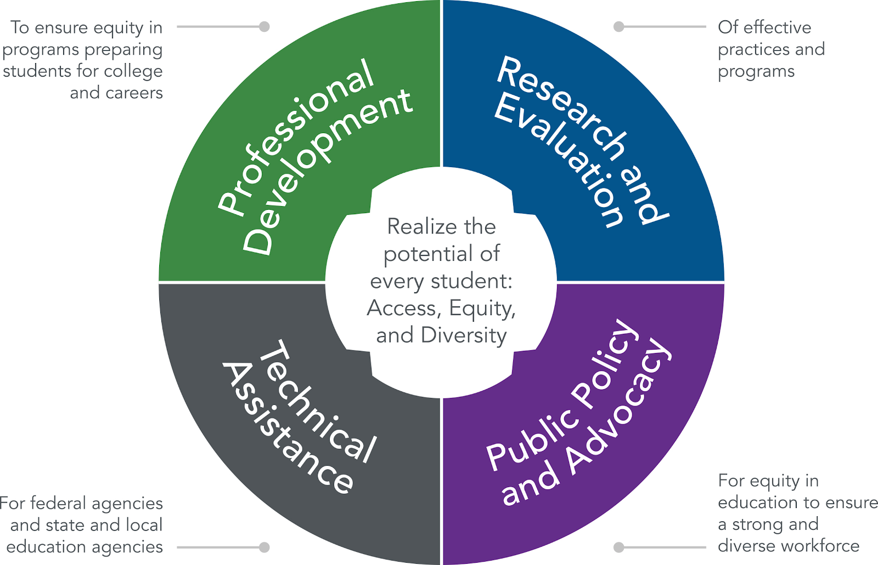
How does NAPE make an impact?
Our Focus Areas

Slide 3

Our Mission
We build educators’ capacity to implement effective solutions for increasing student access, educational equity and workforce diversity.

Slide 4




(UA)²
© NAPE EF 2022
Notes:
Cyclical learning not linear- Educators who seek to move toward equity interrogate how their own perceptions and actions hinder the well being of their students.

Slide 5
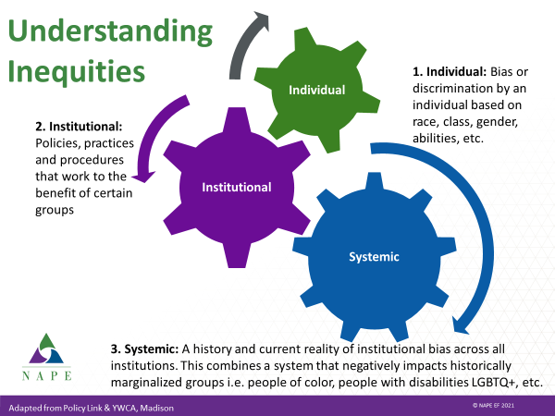
Notes:
SILVIA
This requires that we reflect on awareness at all levels

Slide 6
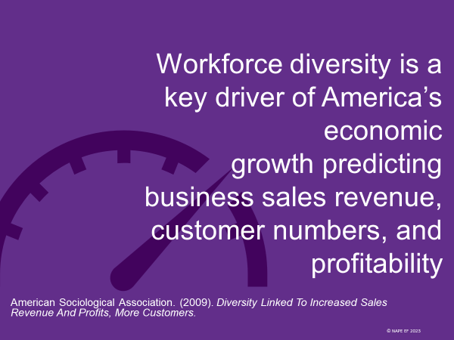

Slide 7
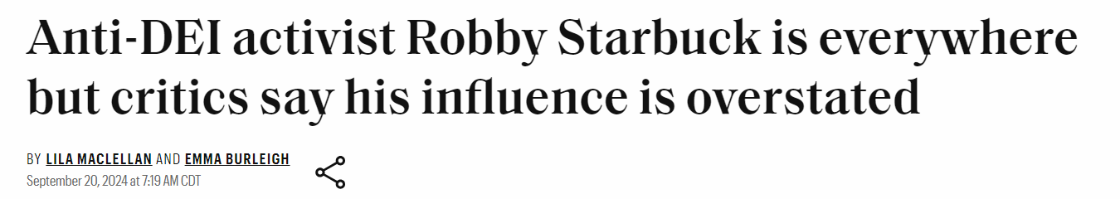
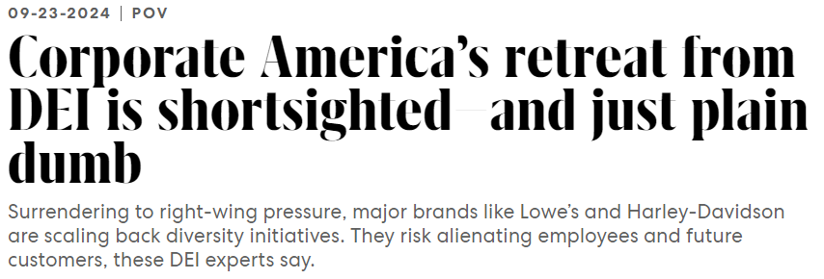
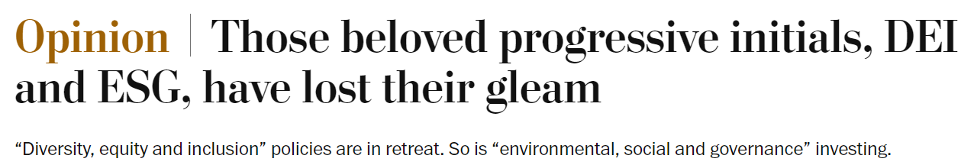

Slide 8
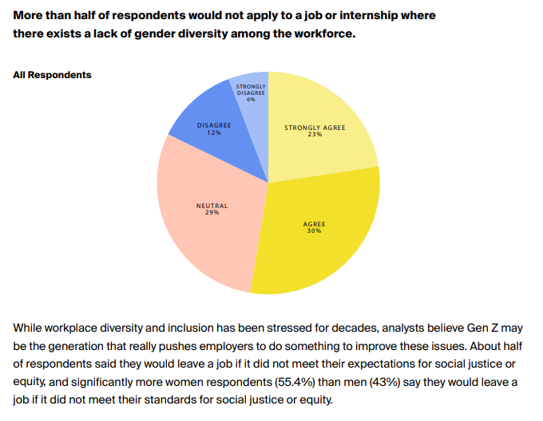
Other Insights?
57% of Executives in an early 2024 Littler survey reported that their organizations expanded their DEI activities over the previous year, even despite the backlash (36% are holding steady, 6% reported active decrease)
A Pew Research Center survey found that 56% of workers see DEI in the workplace as “a good thing” and 28% see it as neutral. 16% see it as bad.

Slide 9

Too often, we blame students for the system’s failure to serve them adequately. Nothing needs to be “fixed” about our learners. The key to addressing root causes at the system level is to put the student (or learner) at the center of the equation.

Slide 10
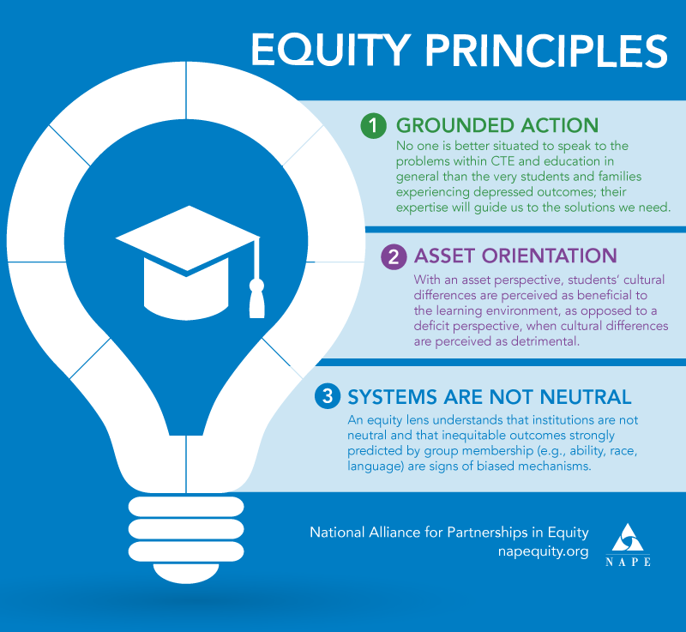

Notes:
Article: https://napequity.org/wp-content/uploads/Perkins-V-Equity-Principles-for-Comprehensive-Local-Needs-Assessment-2020-02-21.pdf

Slide 11
Let’s Connect
What does this mean for our postsecondary learners?
What do they need from us?
What mindsets and mental models do we need to affirm or disrupt to get us there?

Slide 12

1960-2008
More than 25% of the growth in productivity is associated with reducing occupational barriers for Black people and women
Turner, A. (2023), The Business Case For Racial Equity: A Strategy For Growth
© NAPE EF 2023

Slide 13
So, where is a starting point?
Explore-
Take Inventory
Discover-
Review and Analyze
Select – Research Strategies
Select – Decide on a High-Impact Strategy
Act - Implement
Implement the strategy and plan. Measure results
Assess equity gaps based on available data
Research strategies proven to address the root causes
Get curious and creative about what is feasible given local resources
Research root causes and develop a hypothesis
Program Improvement Process for Equity

Slide 14
A pre-to-post survey of CTE and STEM faculty from 15 community and technical colleges representing 11 states who attended NAPE’s Micromessaging Academy demonstrated:
A statistically significant increase in educator self-efficacy
> 200% increase in equity knowledge and skills
98% agreed with the statement “I believe all students can succeed in STEM disciplines.”
The Impact of Equity - Postsecondary
© National Alliance for Partnerships in Equity

Slide 15
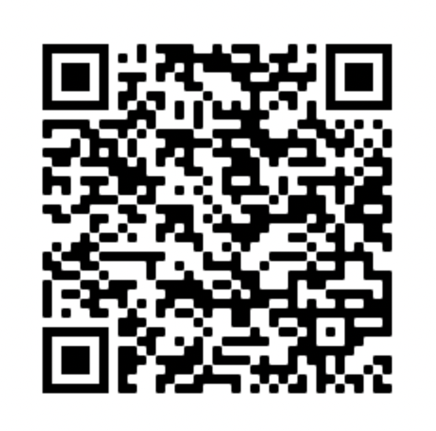
Moving This Conversation Forward
Learn
–Visit the QR code to learn more about professional development NAPE offers
Connect
–Email me: bbrady@napequity.org
Address
Tel
Web
320 Commons Drive Suite 324
Parkesburg, PA 19365
717-407-5118
Napequity.org

Slide 16

THANK YOU
National Alliance for Partnerships in Equity
Napequity.org

