Slide 1

Activating Research to Advance Change in Postsecondary CTE
V. Scott H. Solberg
Center for Future Readiness
Boston University
Coalition for Career Development Center

Slide 2
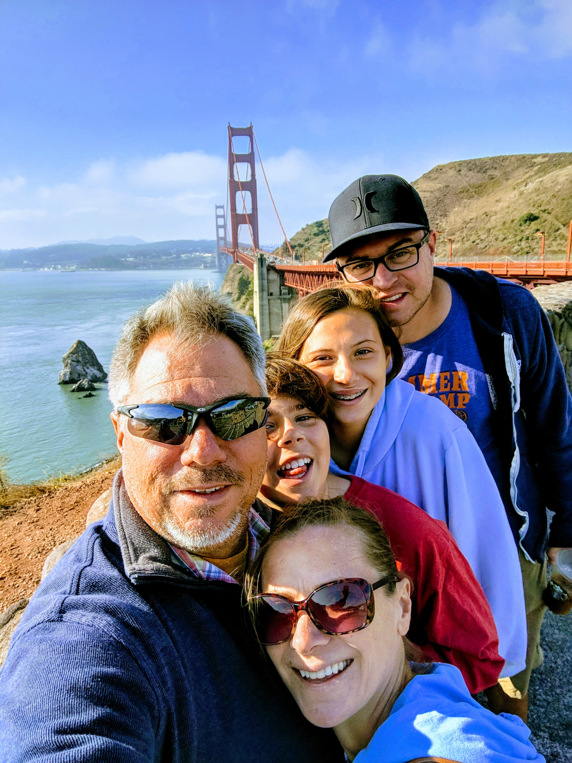
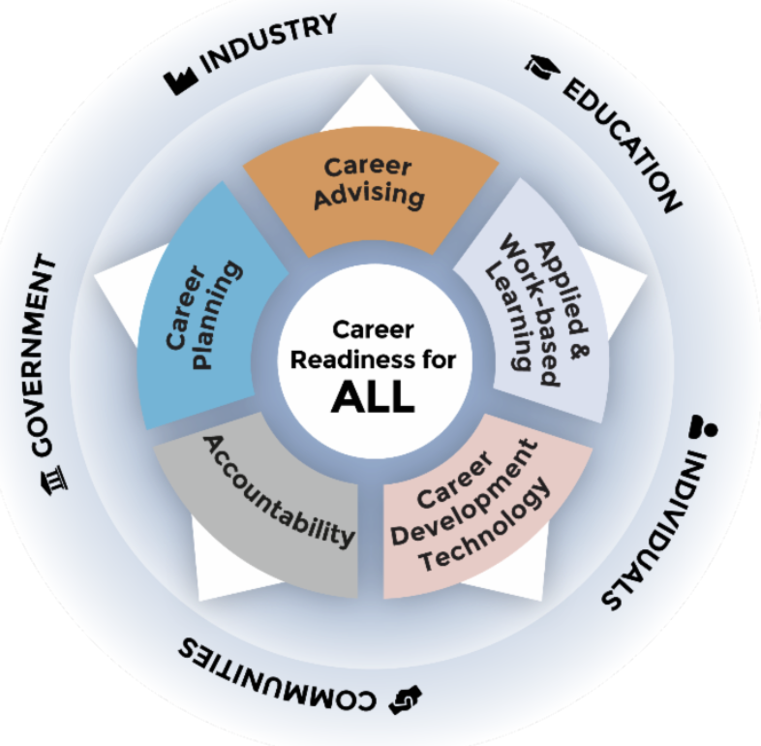


Background
West Valley Community College
Milwaukee Area Technical College
Coalition for Career Development Center
Boston University

Slide 3

Agenda
Career Readiness in the U.S.
Identify Pathways
Redesign Postsecondary CTE
Building a Career Readiness Infrastructure

Slide 4

What Does the Research Say About...
Economic Outlook for Young Adults?
Impact of Quality Career Readiness Programs on Future Earnings?

Slide 5
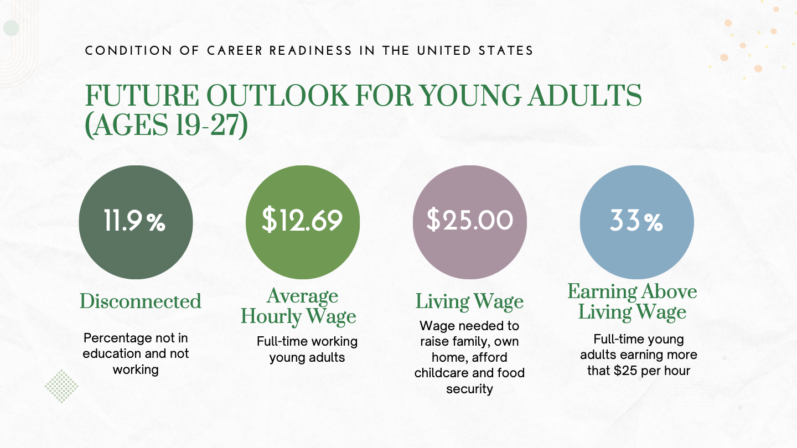

Slide 6

Identify Occupational Pathways to Social Mobility
Gather evidence about regional high-wage, high demand opportunities
Assess alignment between occupational opportunities and postsecondary pathways
Gather data on extent to which course learning objectives within pathways align with industry needs for durable and technical skills

Slide 7
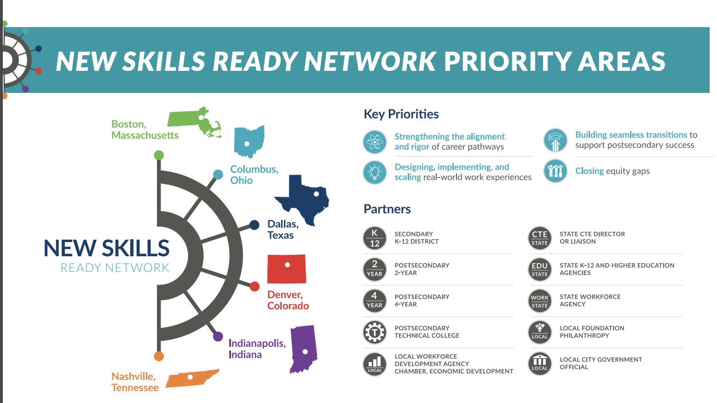
1. Identify High-Wage, High Demand Pathways

Slide 9
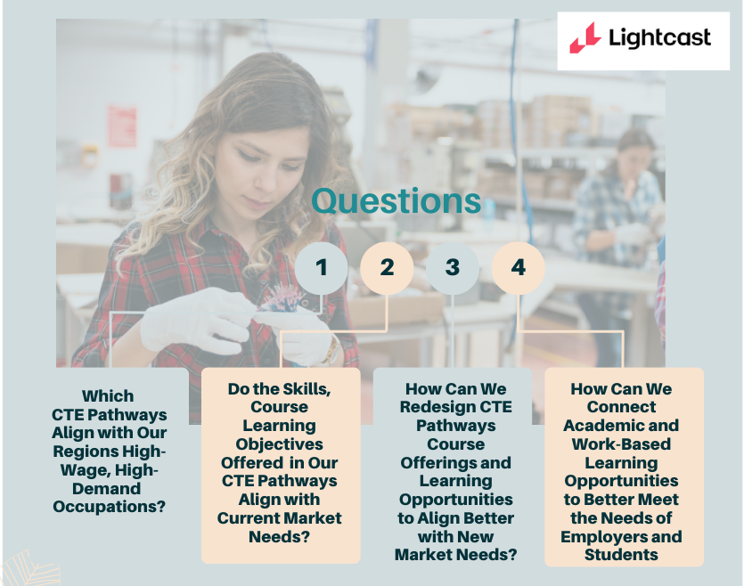

Slide 10
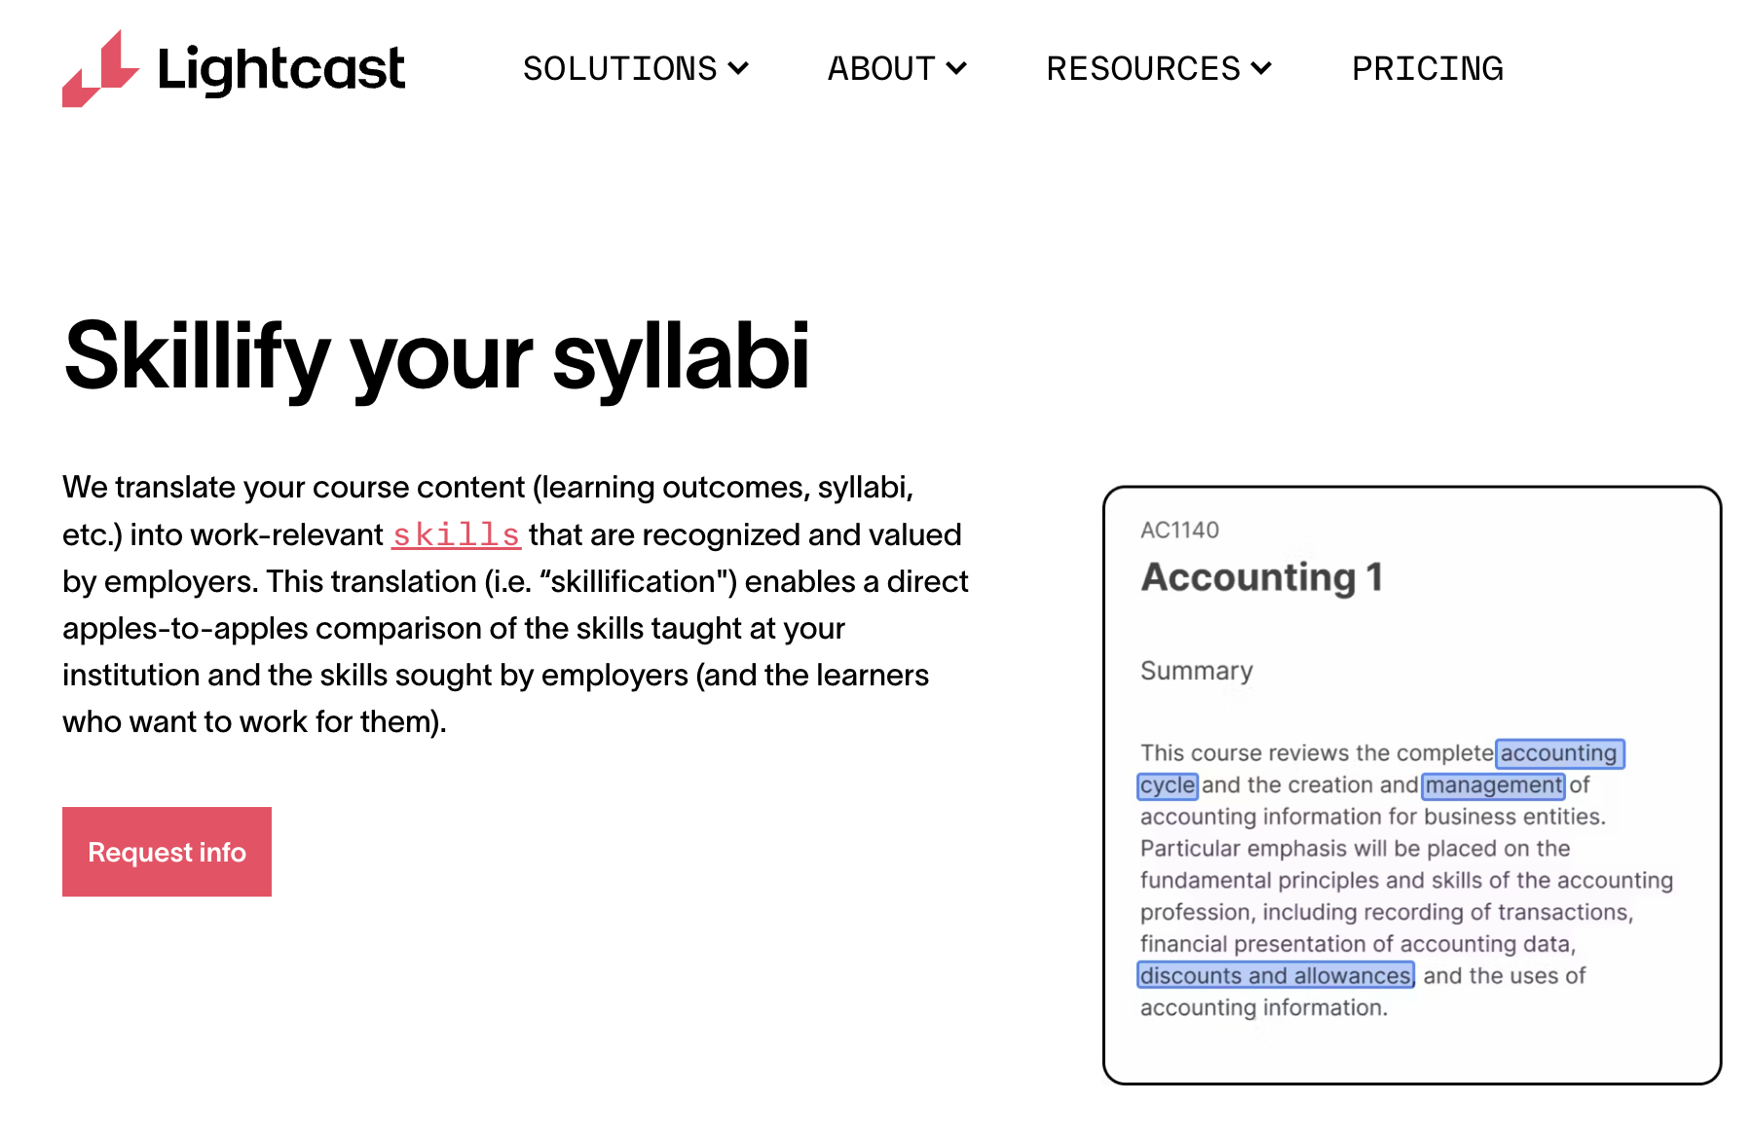

Slide 11
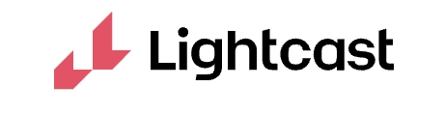
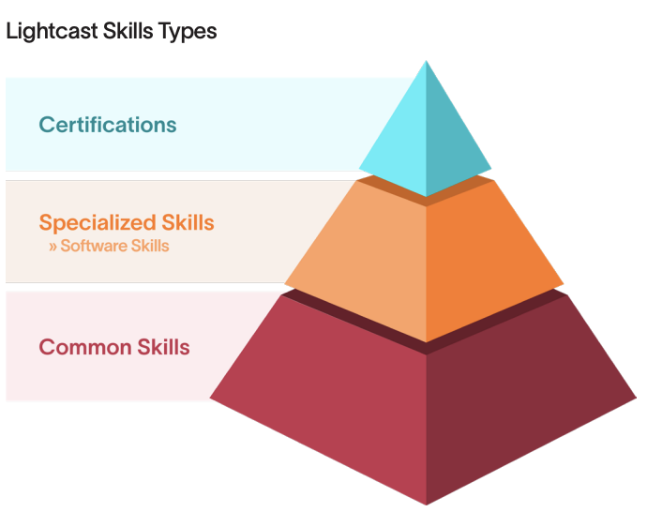
Designing Pathways Involves Exploration of…
Similar: jobs with comparable salary
Lateral Transition: Comparable salary in a different occupation
Advancement: Higher salary in same occupation pathway
Lateral Advancement: Higher salary in a different occupational pathway

Slide 12
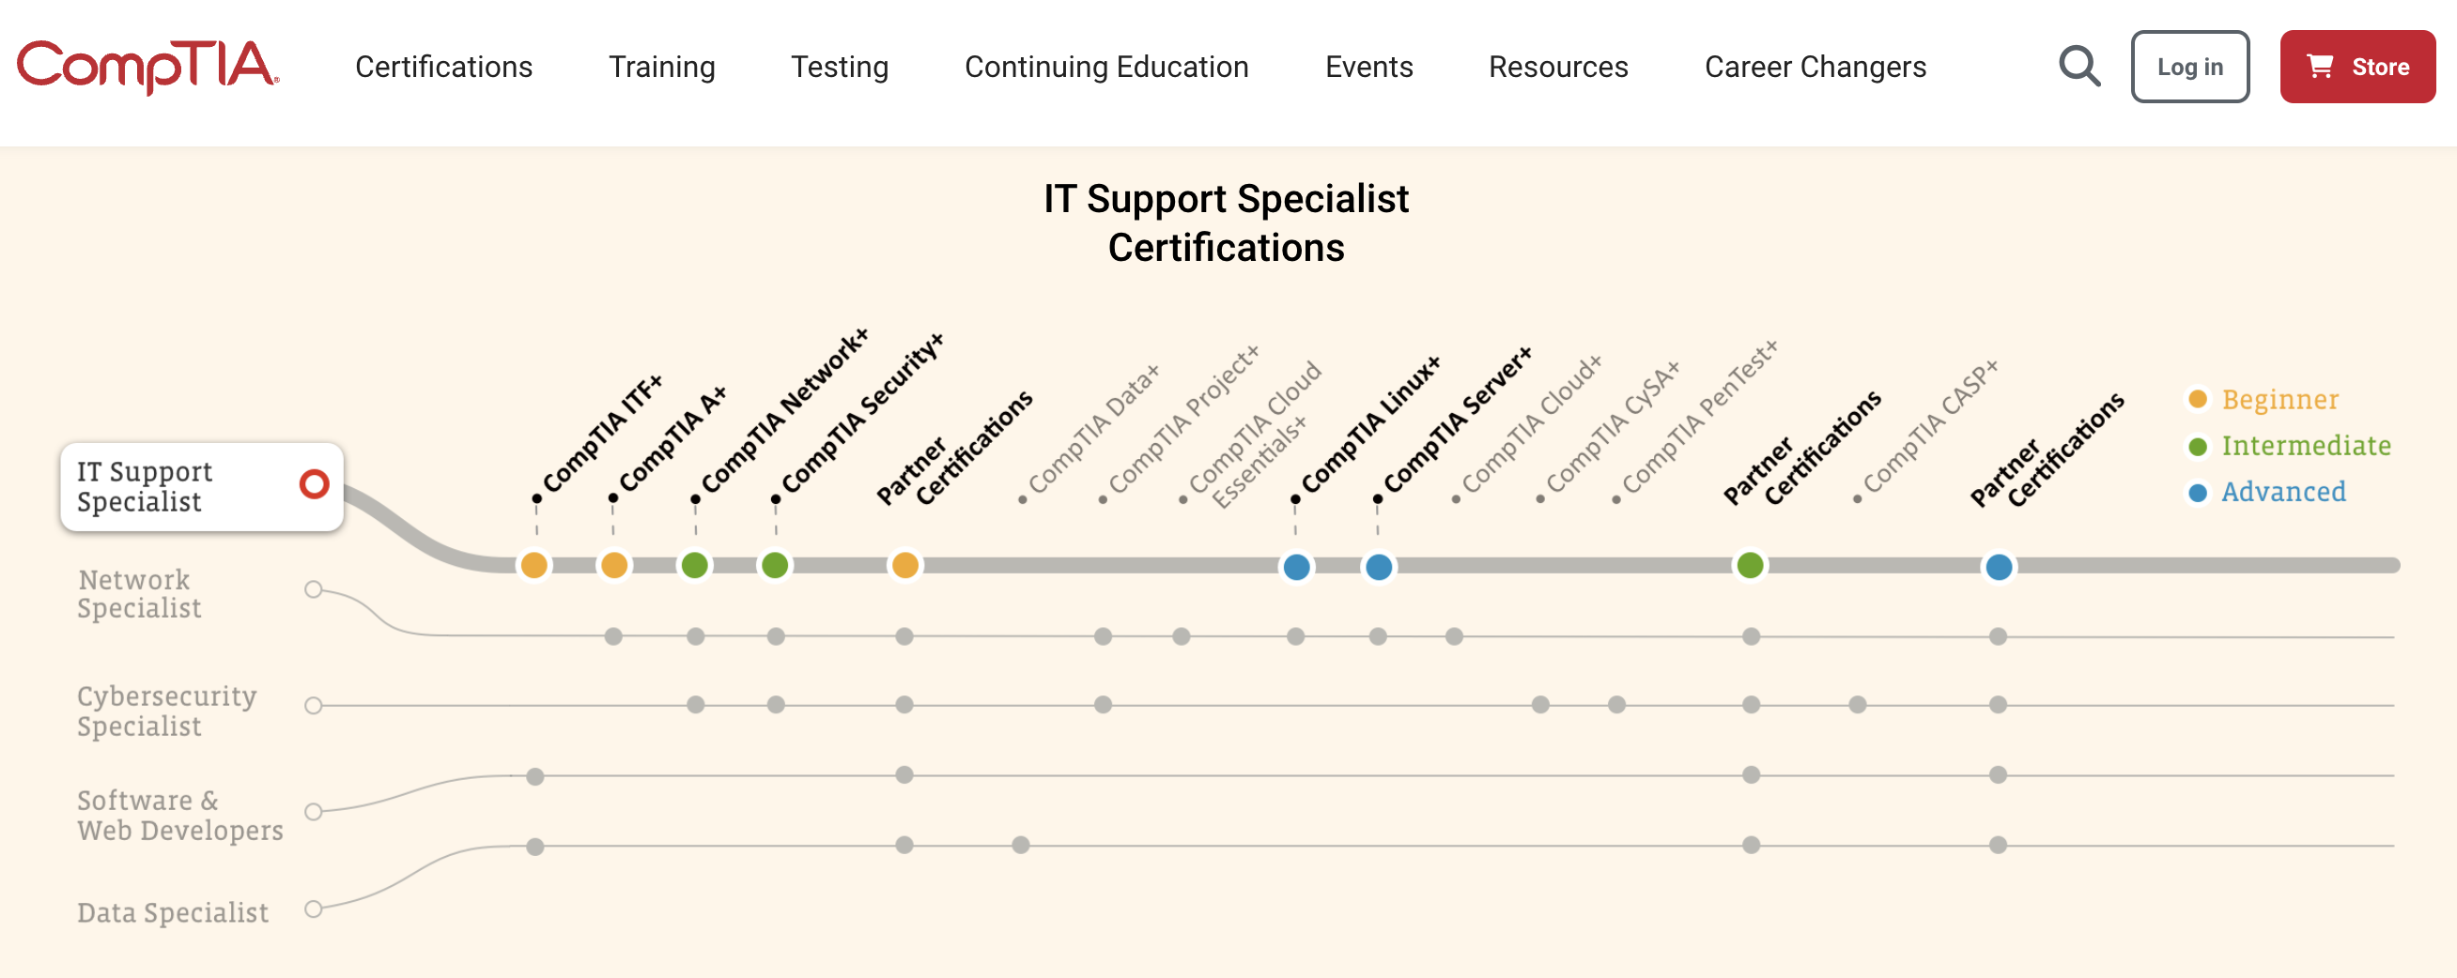
Planning Future Pathways

Slide 13
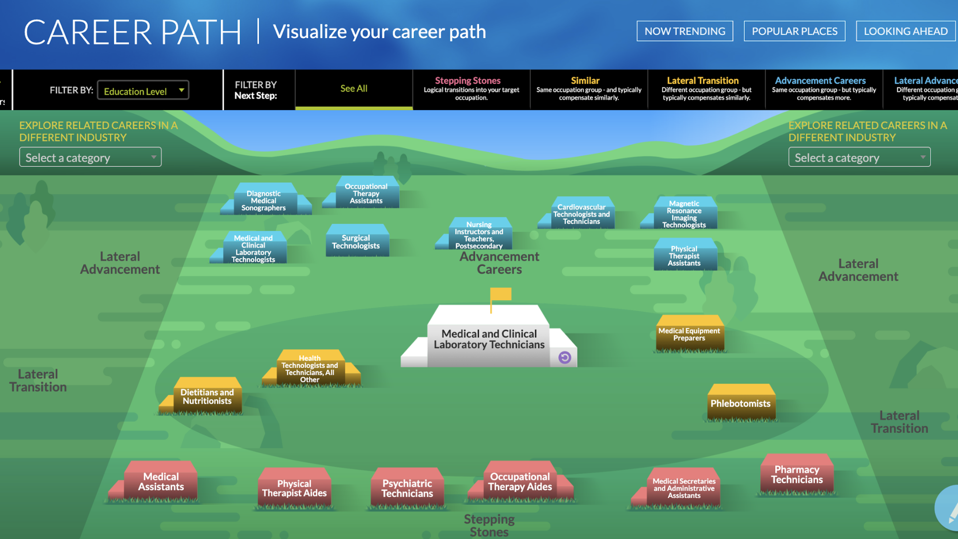

Slide 14
Redesigning Postsecondary CTE Using Career Advising and Individualized Career Plans

Slide 15

Invest in Comprehensive Future Readiness Programs and Services
Evidence: Settings that engage individuals in a comprehensive individualized career plan program are more engaged academically, have better employment outcomes, and skills that more closely align to Industry needs
Translation to Program Design: Design a comprehensive individualized career plan strategy throughout the two-year college experience from application to graduation and beyond.

Slide 16

Individualized Career Plans
Student-driven
Integrated scope and sequence of activities throughout postsecondary from application to graduation
Discover emerging talent
Connect emerging talent to CTE Pathways
Design pathway to social mobility (i.e., living wage)

Slide 17

Talent Pipeline Management
Use individualized career plans to help individuals discover how their talent aligns with high-wage pathways
Create connected learning and work-based learning opportunities that increase engagement with mentors from business and industry
Establish funding and mentoring for entrepreneurial development opportunities

Slide 18

Access to Encouraging Conversations
Evidence: Future wage earnings increase for each meaningful conversation one receives about their future occupational opportunities
Translation to Program Design: Increase access to caring and encouraging adult mentors and coaches

Slide 19

Considerations
Access to encouraging role models who reflect their background
Focus on building social capital
Professional development to ensure students understand how to perform business related tasks and socialize with employers
Access to professional clothes

Slide 20
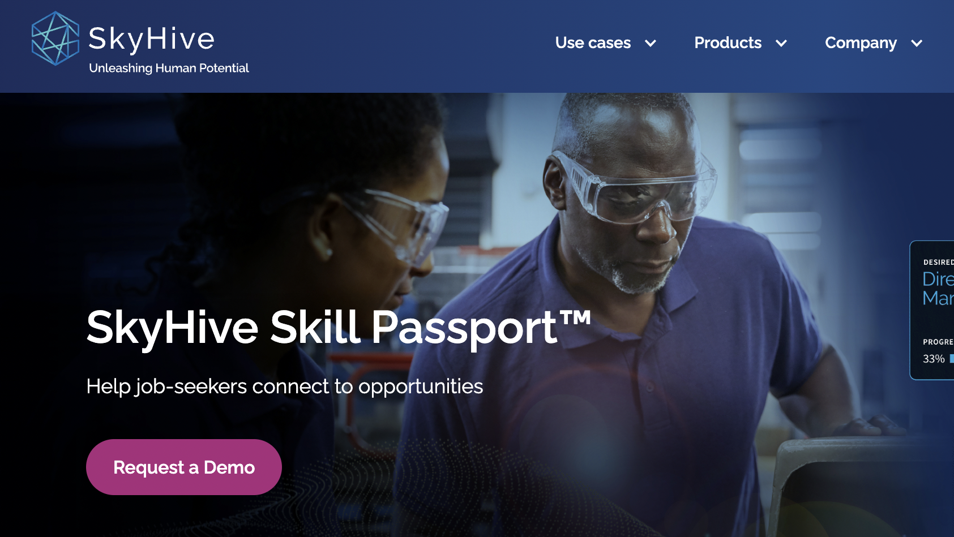

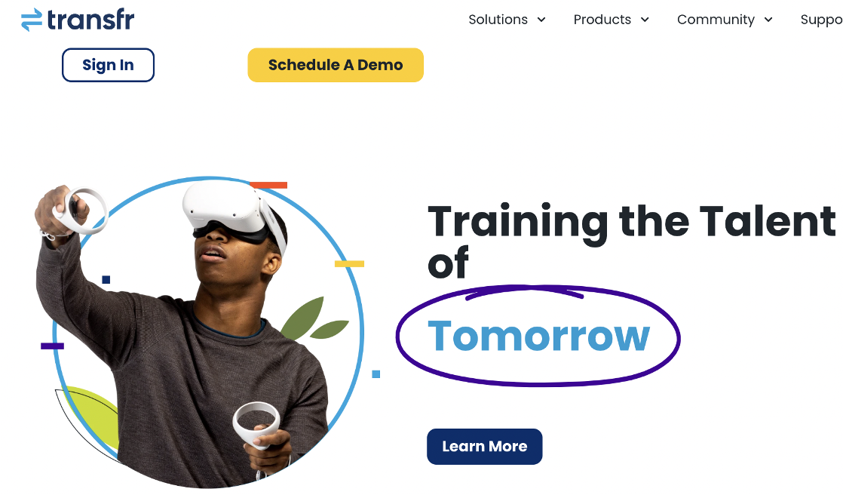
Building a Career Readiness Infrastructure:
Developing Navigation Skills Using Career Technology

Slide 21

Building a Career Readiness Infrastructure
Creating and army of career mentors/coaches
Designing and collaborating with workforce development intermediaries

Slide 22
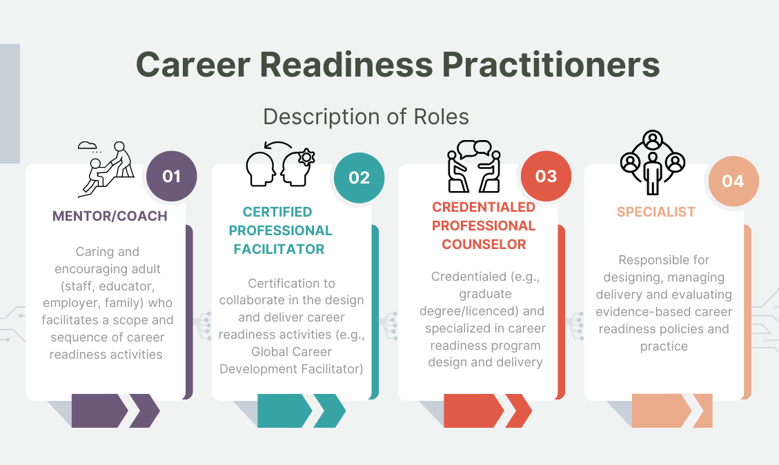

Slide 23
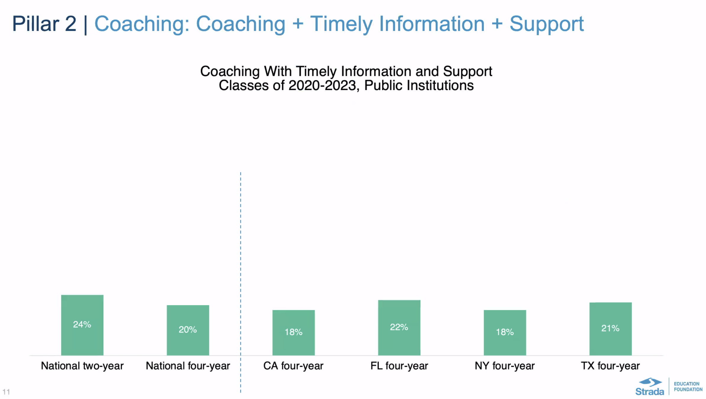

Slide 24
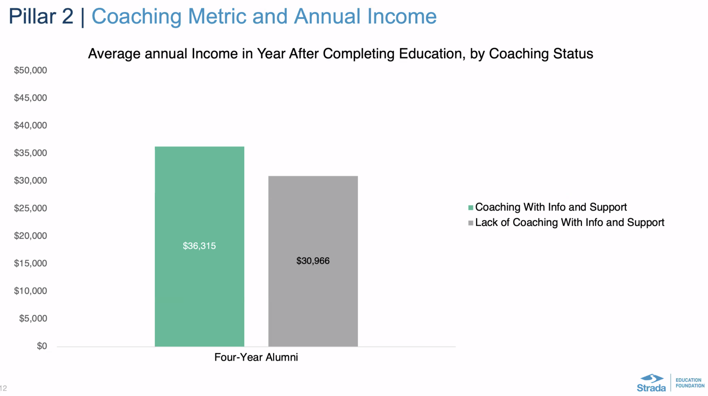

Slide 25
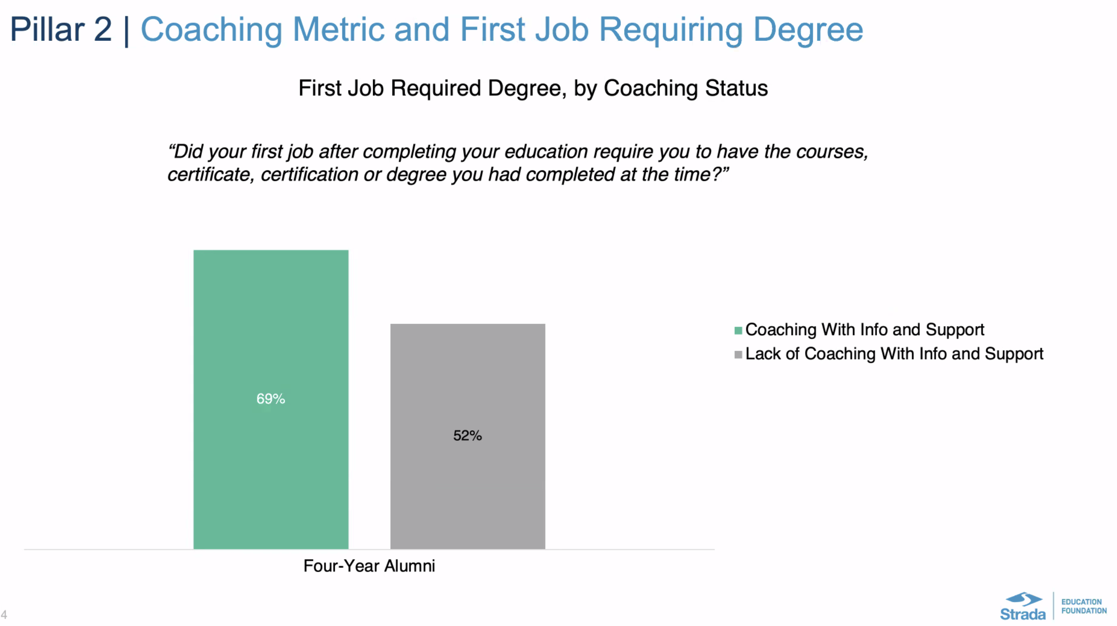

Slide 26
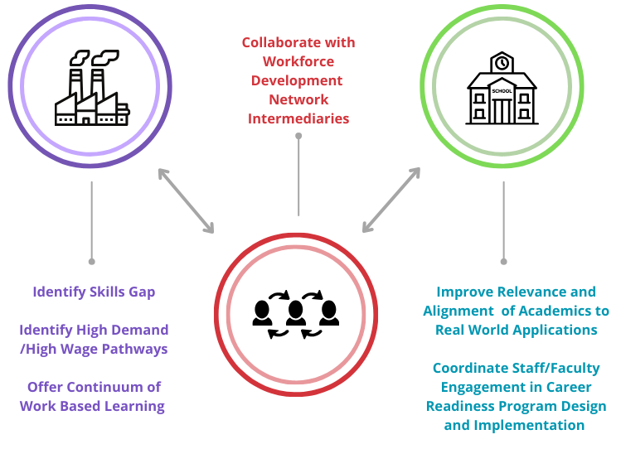

Slide 27
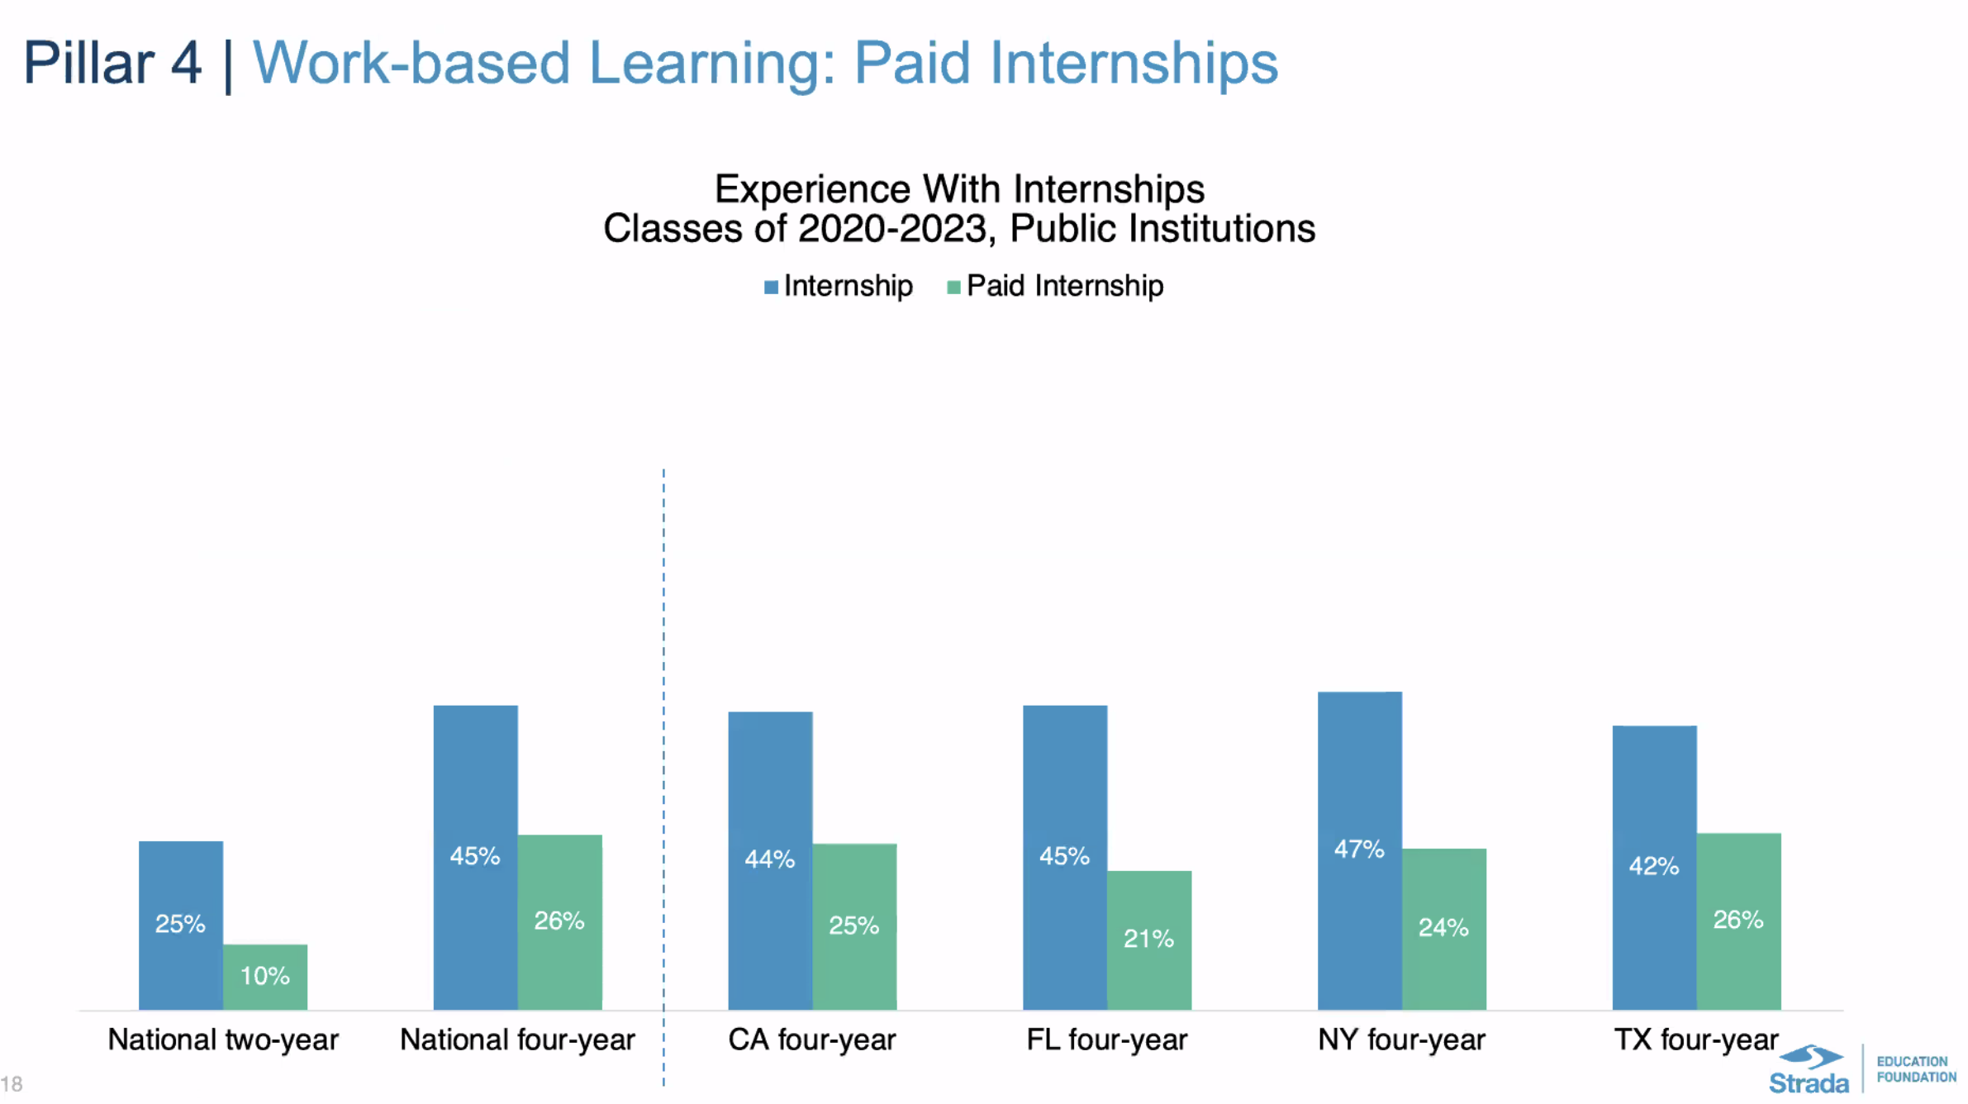

Slide 28
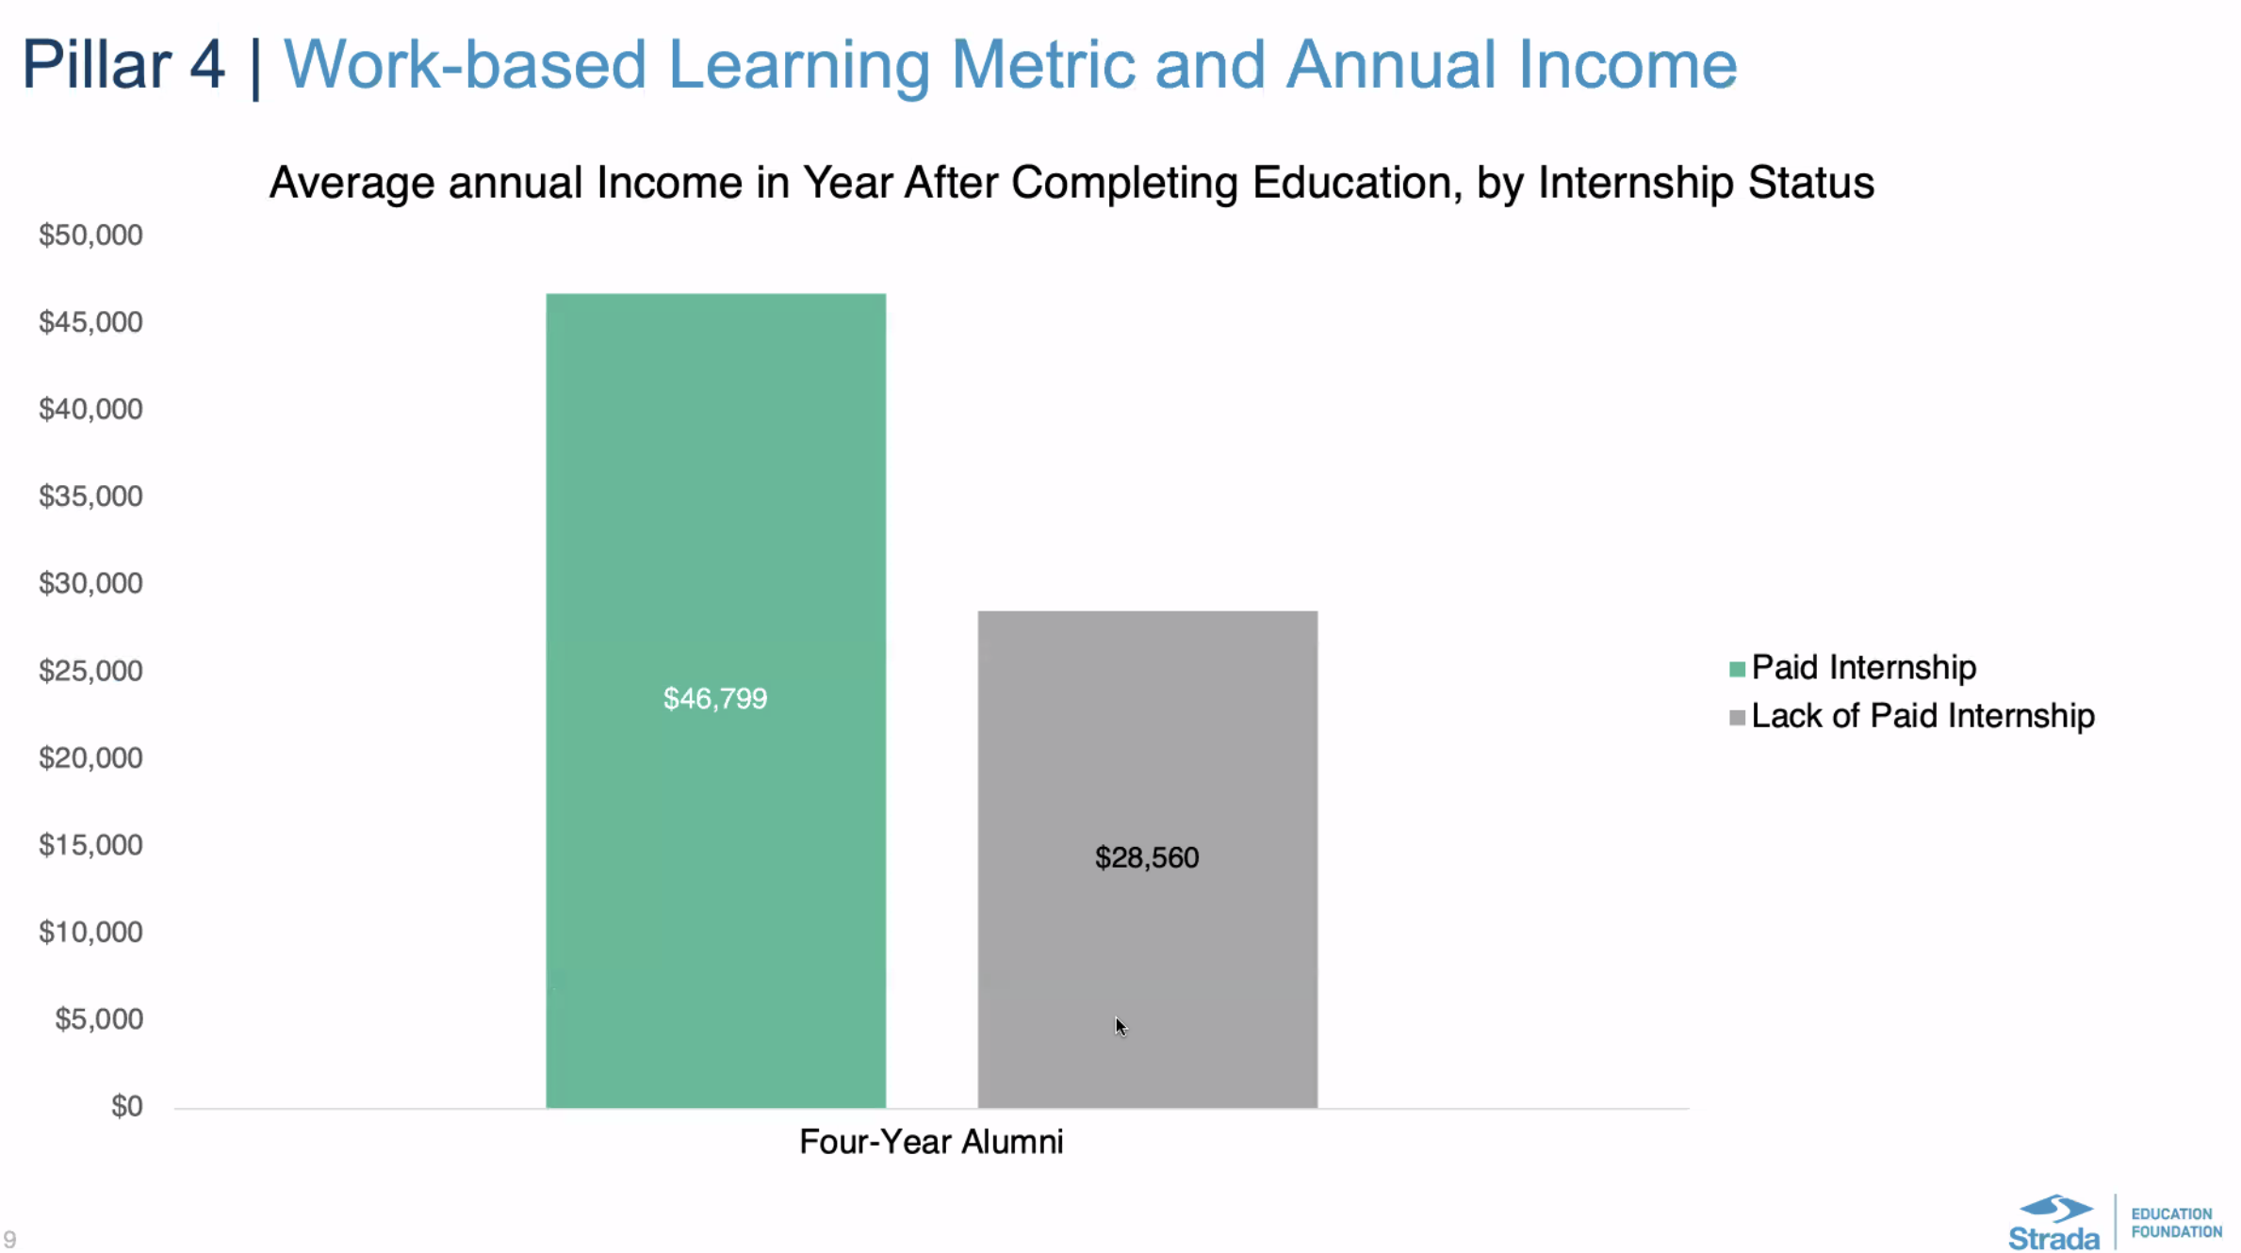

Slide 29



Sources of Evidence
Solberg, V. S. H., Donnelly, H. K., Kroyer-Kubicek, R., Basha, R., Curtis, G., Jaques, E., Schreiber, K. (2022). Condition of Career Readiness in the United States. Alexandria, VA: Coalition for Career Development Center and the BU Center for Future Readiness.
Mann, A., Denis, V. & Percy, C. (2021). Career ready? How schools can better prepare young people for working life in the era of COVID-19. OECD Education Working Papers No. 24.
Solberg, V.S., Wills, J., Redmond, K. & Skaff, L. (2014). Use of individualized learning plans as a promising practice for driving college and career readiness efforts: Findings and recommendations from a multi-method, multi-study effort (ISBN: 1-933493-46-1). Washington, DC: National Collaborative on Workforce and Disability for Youth, Institute for Educational Leadership.
Torre Gibney, T., & Rauner, M. (2021). Education and career planning in high school: A national study of school and student characteristics and college-going behaviors (REL 2022–127). U.S. Department of Education, Institute of Education Sciences, National Center for Education Evaluation and Regional Assistance, Regional Educational Laboratory West.

Slide 30
The New Paradigm
What’s Out | What’s In
Career Readiness | Future Readiness
Career Development | Positive Youth and Adult Development
Career Choice and Decision-Making | Navigation, occupational pathways, future, hope, purpose, occupational pathways to social mobility, "what is your next step"
Measure Career Interests and Aptitude | Narrative approaches to transferable skills, Malleable personal qualities such as human/durable skills and technical skills
Guidance | Facilitating, mentoring, coaching, individual-driven, inspiring hope and meaning, discovery, self-exploration, occupational exploration, planning and management
Career Education | Positive development, Talent discovery, Connect talent to pathways

Slide 31

Resource guide - Mentoring
Resources
Holland, C. (n.d.). Workplace Mentoring To Advance Equity. National Association of Workforce Boards. Retrieved January 26, 2023 from https://www.nawb.org/workplace-mentoring
Mentor. (n.d.). College and Career Readiness Mentoring. Retrieved January 26, 2023 from https://www.mentoring.org/resource/college-and-career-readiness-resources/
Mentor. (2021, July 22). Career Readiness Resources for Youth Serving Programs. https://www.mentoring.org/resource/cmws-july-2021-career-readiness-resources-for-youth-serving-programs/
National Mentoring Resource Center. (n.d.). College and Career Success Mentoring Toolkit. Retrieved January 26, 2023 from https://nationalmentoringresourcecenter.org/resource/college-and-career-success-mentoring-toolkit/
National Mentoring Resource Center (n.d.). Resources for Mentoring Programs. Retrieved January 26, 2023 from https://nationalmentoringresourcecenter.org/resources-for-mentoring-programs/
Articles
Bell, A. (2022, June 2). The Power of Mentorship to Support Career Readiness. Chancellor, WGU Indiana, Inside Indiana Business. https://www.insideindianabusiness.com/articles/the-power-of-mentorship-to-support-career-readiness
Ibrahim, D. (2022, August 12). Why Mentorship Matters: The Role of Managing Organizations and Hosts to Show Up and Have Skin in the Game. Education Systems Center, Northern Illinois University. https://edsystemsniu.org/why-mentorship-matters/
Perry, A. M. (2018, October 17). How work-based learning connects students with mentors and experience. Brookings. https://www.brookings.edu/blog/the-avenue/2018/10/17/how-work-based-learning-connects-students-with-mentors-and-experience/

Slide 32
Resource guide - Equity in CTE
Resources
Advance CTE. (2022, December). Achieving Inclusive CTE Goal-Setting Tool. Retrieved February 21, 2023 from https://careertech.org/resource/inclusive-goal-setting-tool
Estes, A., & McCain, B. (2019, September). Four Strategies to Address Equity in CTE. National Association of State Boards of Education. Retrieved February 21, 2023 from https://files.eric.ed.gov/fulltext/EJ1229646.pdf
Smith, R. (2019, August). Advancing Racial Equity in Career and Technical Education Enrollment: By placing a focus on racial equity, CTE programs can help narrow opportunity gaps. Center for American Progress. Retrieved February 21, 2023 from https://www.americanprogress.org/article/advancing-racial-equity-career-technical-education-enrollment/
Reports/articles
Espinoza, A., & Spence, J. (2023, February 8). The Challenge and Opportunities in Addressing Equity in Career Technical Education. AIR. Retrieved February 21, 2023 from https://www.air.org/resource/field/challenges-and-opportunities-addressing-equity-career-and-technical-education?utm_source=iContact&utm_medium=email&utm_campaign=american-institutes-for-research&utm_content=AIR+News+February+2023
UMass Chan Medical School. (2022). Advancing Employment for Secondary Learners with Disabilities through CTE Policy and Practice. Retrieved February 21, 2023 from https://repository.escholarship.umassmed.edu/bitstream/handle/20.500.14038/44302/Advancing_Employment_for_Secondary_Learners_with_Disabilities_CTE_final.pdf?sequence=3&isAllowed=y

Slide 33
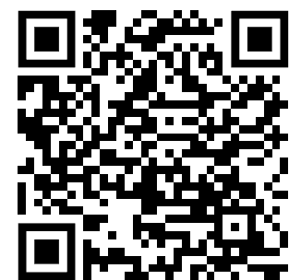
V. Scott H. Solberg, ssolberg@bu.edu
Link to Presentation:
Notes:
Scott

